Slide 1
SQL Components
DDL
DML
DQL
DCL
TCL

Slide 2
DDL
CREATE
ALTER
DROP
TRUNCATE
RENAME

Slide 3
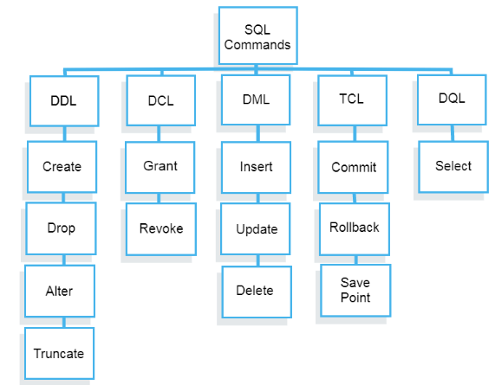

Slide 4
Datatypes
The CHAR datatype stores fixed-length character strings.
When you create a table with a CHAR column, you must specify a string length (in bytes, not characters) between 1 and 2000 for the CHAR column width.
(The default is 1)
Oracle then guarantees that:
When you insert or update a row in the table, the value for the CHAR column has the fixed length.
If you give a shorter value, the value is blank-padded to the fixed length.
If you give a longer value with trailing blanks, blanks are trimmed from the value to the fixed length.
If a value is too large, Oracle returns an error.

Slide 5
The VARCHAR datatype is currently synonymous with the VARCHAR2 datatype.
However, in a future version of Oracle, the VARCHAR datatype might store variable-length character strings compared with different comparison semantics.
Therefore, use the VARCHAR2 datatype to store variable-length character strings.
you specify a maximum string length (in bytes, not characters) between 1 and 4000 for the VARCHAR2 column
The INTEGER data type is an ANSI standard data type, which means it is in all SQL databases.
However, in Oracle, it's a synonym for NUMBER(38).
This means that if you declare an INTEGER column, Oracle is actually declaring a NUMBER column with 38 digits and 0 decimal places.

Slide 6
NCHAR and NVARCHAR2 Datatypes
The NCHAR and NVARCHAR2 datatypes store NLS character data.
The NCHAR datatype stores fixed-length character strings.
The NVARCHAR2 datatype stores variable-length character strings.
National Language Support (NLS) feature allows the use of various character sets .
NUMBER Datatype
The NUMBER datatype stores fixed and floating-point numbers.
specify a precision (total number of digits) and scale (number of digits to the right of the decimal point)
column_name NUMBER (precision, scale)
If a precision is not specified, the column stores values as given.
If no scale is specified, the scale is zero.

Slide 7
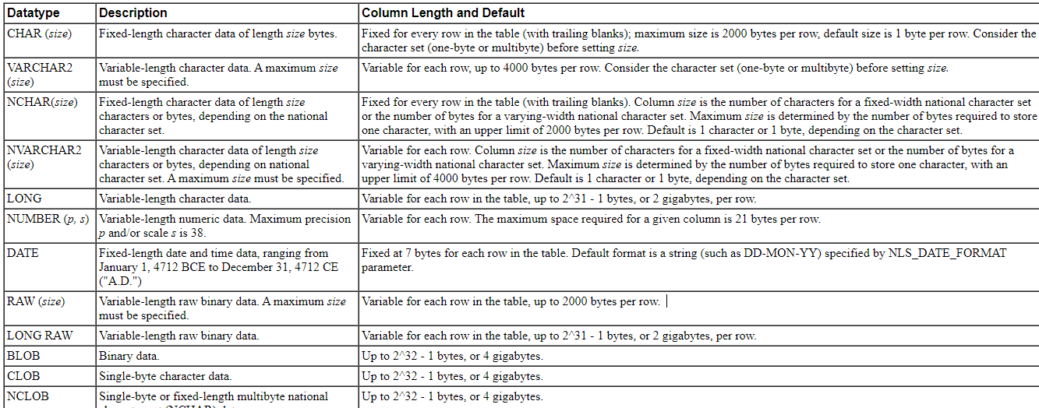

Slide 8
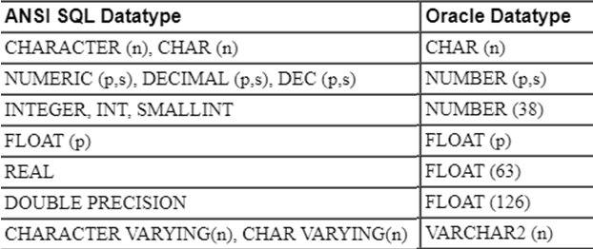

Slide 9
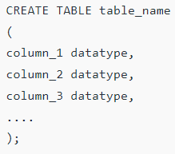

CREATE
create table student_per(sid integer, sname varchar(30));
desc student_per;

Slide 10
cloning
Create a table from a table:
Used to copy the structure & data of the table
CREATE TABLE newtablename [(column name…>]
AS
SELECT <columnname…> from oldtablename;
Eg: Create table t2 as select * from t1;
Or
Create table t2 (id,name) as select id,name from t1;
To copy the structure alone without any records:
CREATE TABLE newtablename [(column name…>]
AS
SELECT <columnname…> from oldtablename where condition;
Eg:
Create table t3 as select * from t1 where 0=1;

Slide 11
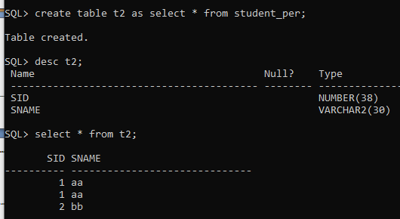
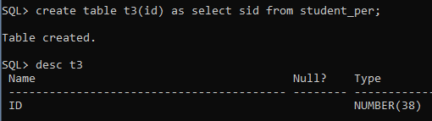

Slide 12
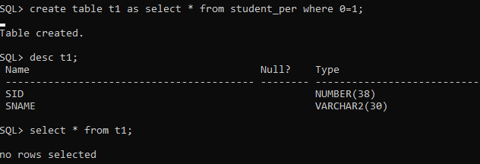

Slide 13
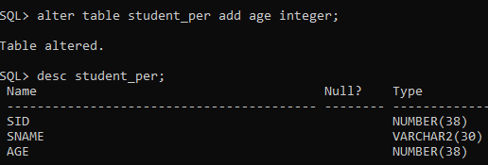

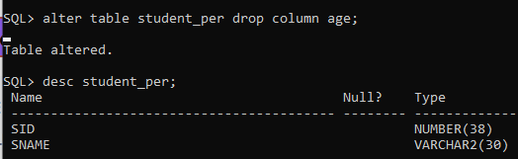
ALTER
This command is used to add, delete or change columns in the existing table.
To add a column
To drop a column
ALTER TABLE table_name DROP COLUMN column_name;
To drop multiple columns in an existing table:
ALTER TABLE table_name DROP (column_name1, column_name2,…);

Slide 14
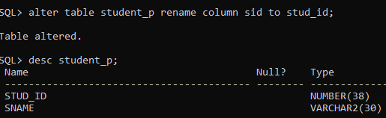
To rename a column
ALTER TABLE table_name RENAME COLUMN old_column_name TO new_column_name;

Slide 15
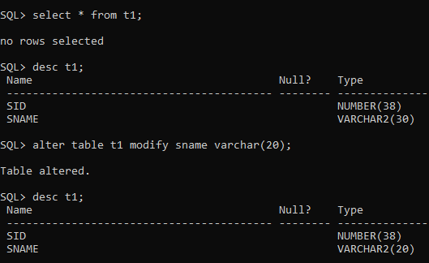
To modify a column
ALTER TABLE table_name
MODIFY column_name column_type;

Slide 16
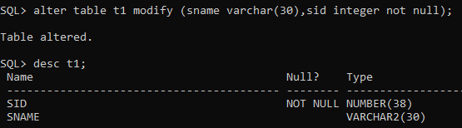
To alter multiple columns

Slide 17
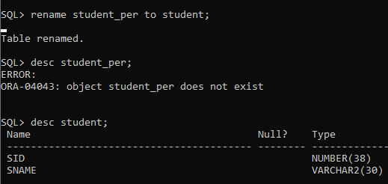
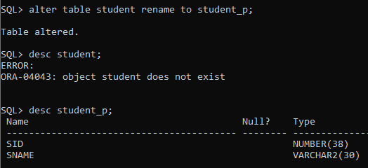
Rename the table
Syntax: RENAME oldtablename to newtablename;
SQL> rename emp to emp1;
Table renamed.
SQL> desc emp1;
Name Null? Type
----------------------------------------- -------- ----------------
EID NOT NULL NUMBER
ENAME VARCHAR2(30)
DEPTNAME VARCHAR2(30)
SALARY NUMBER
Or
ALTER TABLE oldtablename RENAME TO newtablename;
SQL> alter table emp1 rename to emp;
Table altered.
SQL> desc emp;
Name Null? Type
----------------------------------------- -------- --------------------------
EID NOT NULL NUMBER
ENAME VARCHAR2(30)
DEPTNAME VARCHAR2(30)
SALARY NUMBER

Slide 18
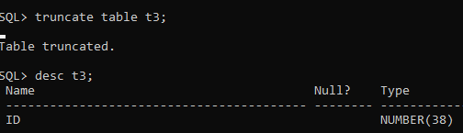
truncate the table
This command is used to remove all rows from the table, but the structure of the table still exists.
Syntax – TRUNCATE TABLE table_name;
select table_name from user_tables; (to list all the tables created in the default database)

Slide 19
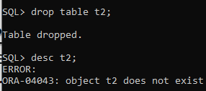
DROP the table
To delete the table structure or table from the tablespace.
Syntax:
DROP TABLE tablename;
Note: In Oracle 10g the default action of a DROP TABLE command is to logically move the table to the recycle bin by renaming it, rather than actually dropping it.
DROP WITH PURGE:
To drop the table and release the space associated with it in a single step.
If you specify PURGE, then the database does not place the table and its dependent objects into the recycle bin.
Syntax:
DROP TABLE tablename PURGE;
PURGE TABLE tablename;
Or
Drop table t1;
Purge table t1;

Slide 20
Recyclebin:
oracle 10g has recyclebin-kind of retirement home for old and dropped tables.
SQL>show recyclebin;
Flashback:
Can recover a table that have dropped from the recyclebin using flashback table command
FLASHBACK TABLE tablename TO BEFORE DROP;
SQL> drop table books;
SQL>shoq recyclebin;
SQL>flashback table books to before drop;

Slide 21
SQL Alias:
SQL Aliases are defined for columns and tables. Basically aliases is created to make the column selected more readable.
SELECT oldcolumnname AS newcolumnname FROM tablename;
Or
SELECT oldcolumnname newcolumnname FROM tablename;
SQL> select eid as employeeid from emp1;
or
SQL> select eid employeeid from emp1;
EMPLOYEEID
----------
1
2
SQL> select e.ename,e1.salary from emp e,expenses e1 where e.eid=e1.eid;
ENAME SALARY
------------------------------ ----------
aa 20000
bb 30000
dd 70000
cc 60000
aa 100000

Slide 22
DML
INSERT
DELETE
UPDATE

Slide 23
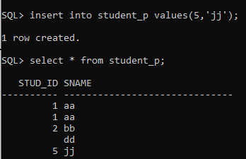
insert
To insert all values
To insert dynamically
To insert a specified column value
To insert all values
INSERT INTO table VALUES (value1,…);
or
INSERT INTO table (column1,…)
VALUES (value1,…);
To insert dynamically
insert into t1 values(&sid,'&sname');

Slide 24
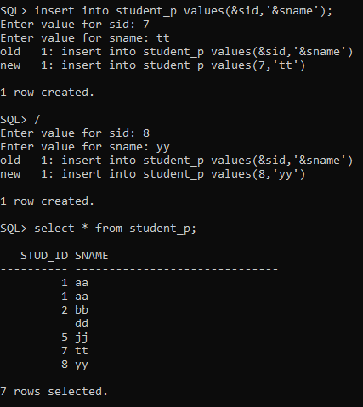
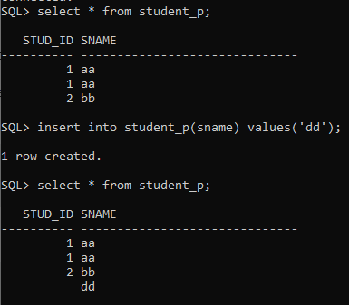
To insert dynamically
To insert a specified column value

Slide 25
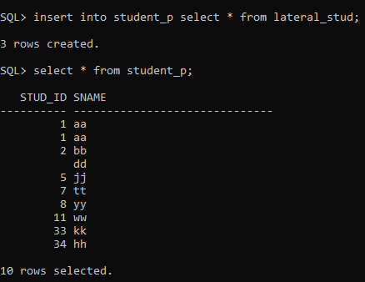
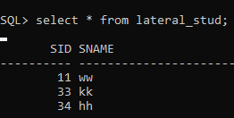
Inserting all columns of a table – INSERT INTO SELECT Statement
INSERT INTO first_table SELECT * FROM second_table;
Inserting specific columns of a table – INSERT INTO SELECT Statement
INSERT INTO first_table(names_of_columns1)
SELECT names_of_columns2 FROM second_table;
Copying specific rows from a table – INSERT INTO SELECT Statement
INSERT INTO table1 SELECT * FROM table2 WHERE condition;
first_table: name of first table.

Slide 26
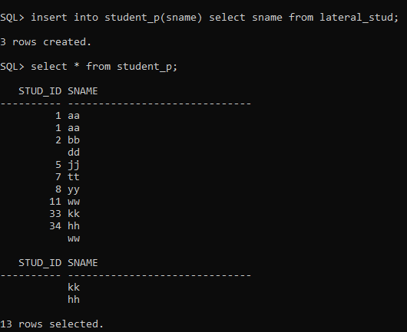

Slide 27
SET SERVEROUTPUT ON SIZE 1000000;
SET LINESIZE 100;
set pagesize 50000;
set long 50000;
SET SERVEROUTPUT ON SIZE 1000000:
maximum size of Oracle DBMS_OUTPUT or size of set Serveroutput in Oracle
This value can range from 2,000 to 1,000,000
SET LINESIZE 32767:
The maximum line size is 32767 bytes
set long 50000:
Sets maximum width (in bytes) for displaying LONG, BLOB, BFILE, CLOB, NCLOB and XMLType values; and for copying LONG values.

Slide 28
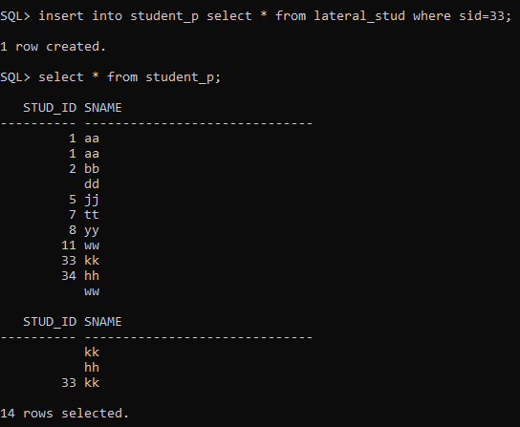

Slide 29
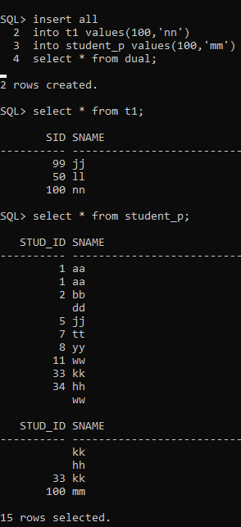
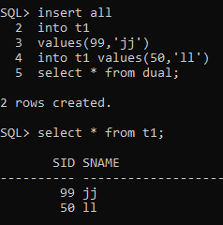
The Oracle INSERT ALL statement is used to insert multiple rows with a single INSERT statement. You can insert the rows into one table or multiple tables by using only one SQL command.
INSERT ALL
INTO table_name (column1, column2, column_n) VALUES (expr1, expr2, expr_n)
INTO table_name(column1, column2, column_n) VALUES (expr1, expr2, expr_n)
INTO table_name (column1, column2, column_n) VALUES (expr1, expr2, expr_n)
SELECT * FROM dual;
Inserting on different table
Inserting Multiple rows on same table

Slide 30
DUAL : It is a table that is automatically created by Oracle Database along with the data dictionary.
DUAL is in the schema of the user SYS but is accessible by the name DUAL to all users.
It has one column, DUMMY, defined to be VARCHAR2(1), and contains one row with a value X.
What does SELECT 1/* from dual mean?
, SELECT 1 FROM DUAL; or SELECT * FROM DUAL; will simply returns 1 or X .
You need it because the INSERT ALL syntax demands a SELECT clause but you are not querying the input values from a table.
SYS:
All base (underlying) tables and views for the database data dictionary are stored in the SYS schema.
https://www.complexsql.com/oracle-system-tables/

Slide 31
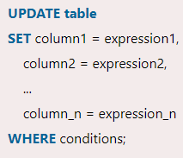
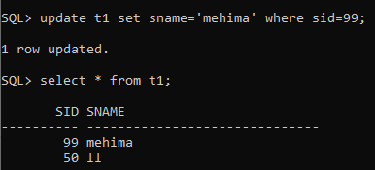
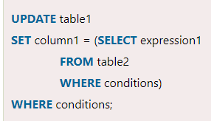
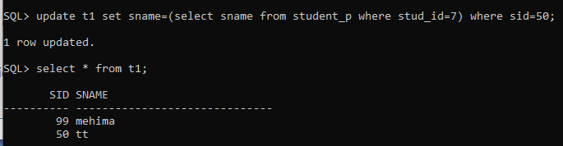
update
UPDATE statement is used to update the existing records in a table
Syntax:
Update Table by selecting rocords from another table
Syntax:

Slide 32
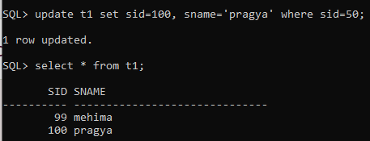
Update multiple columns

Slide 33

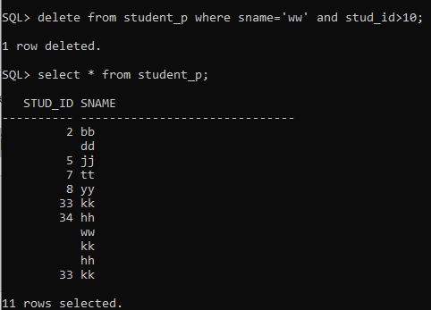
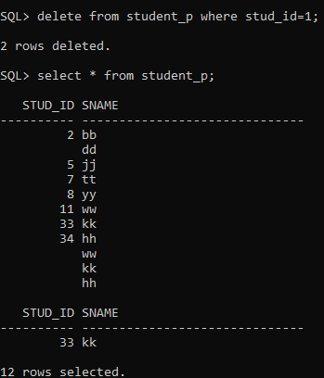
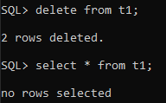
delete
DELETE statement is used to remove or delete a single record or multiple records from a table
On multiple conditions
On one condition
To delete all records

Slide 34

DQL
select
The Oracle SELECT statement is used to retrieve data from one or more than one tables, object tables, views, object views etc.
To select all fields:
SELECT * FROM customers;
To select needed columns:
Select col1,col2… from tablename where conditions;

Slide 35
Integrity constraints
Oracle uses integrity constraints to prevent invalid data entry into the base tables of the database.
You can define integrity constraints to enforce the business rules that are associated with the information in a database.

Slide 36
Integrity constraints
Rules that restrict the values
Constraint clause appear in CREATE and ALTER TABLE statements.
Defined in two ways
Column-level definition
Table-level definition
They are
Primary key
Unique
Check
Not null
Default
Null
Foreign key

Slide 37
Integrity Constraint States
specify a constraint as enabled (ENABLE) or disabled (DISABLE) and also VALIDATE and NOVALIDATE.
If a constraint is enabled, data is checked as it is entered or updated in the database, and data that does not conform to the constraint is prevented from being entered.
If a constraint is disabled, then data that does not conform can be allowed to enter the database.
validate, can specify that existing data in the table must conform to the constraint .
novalidate, not ensured that existing data conforms.
An integrity constraint defined on a table can be in one of the following states:
ENABLE, VALIDATE
ENABLE, NOVALIDATE
DISABLE, VALIDATE
DISABLE, NOVALIDATE

Slide 38
Primary key
It will accept only unique values(not same values)
Each table should have a primary key, and each table can have only ONE primary key.
Automatically set to not null status.(it will not accept null).
Column-level definition in create statement:
CREATE TABLE tablename (columnname datatype constrainttype,columnname datatype,…..);
Eg.
SQL> create table tt1(id int primary key, name varchar2(30));
Table created.
or
SQL> create table tt1(id number constraint pk primary key, name varchar2(30));
Table created.

Slide 39
SQL> create table tt1(id int primary key, name varchar2(30));
Table created.
SQL> insert into tt1 values(&id,'&name');
Enter value for id: 12
Enter value for name: werr
old 1: insert into tt1 values(&id,'&name')
new 1: insert into tt1 values(12,'werr')
1 row created.
SQL> /
Enter value for id: 13
Enter value for name: wee
old 1: insert into tt1 values(&id,'&name')
new 1: insert into tt1 values(13,'wee')
1 row created.
SQL> /
Enter value for id: 12
Enter value for name: ereg
old 1: insert into tt1 values(&id,'&name')
new 1: insert into tt1 values(12,'ereg')
insert into tt1 values(12,'ereg')
*
ERROR at line 1:
ORA-00001: unique constraint (SYSTEM.SYS_C004036) violated

Slide 40
Composite key & date format:
Definition - A composite key, in the context of relational databases, is a combination of two or more columns in a table that can be used to uniquely identify each row in the table.
Uniqueness is only guaranteed when the columns are combined; when taken individually the columns do not guarantee uniqueness.
Constraint pk Primary key(id,sid);
Date : ‘dd-mon-yyyy’ ‘23-nov-2009’

Slide 41
Table-level definition:
CREATE TABLE tablename (columnname1 datatype ,columnname2 datatype,…..columnnamen datatype, CONSTRAINT constraintname type(columnname) );
Eg SQL> create table book(bookid int, bookname varchar2(30),authorname varchar2(30), constraint boid_pk primary key(bookid));
Table created.
IN ALTER STATEMENT:
ALTER TABLE tablename ADD CONSTRAINT constraintname constrainttype(columnname);
Eg SQL>alter table book ADD CONSTRAINT boid_pk primary key(bookid);
Renaming Constraints:
ALTER TABLE tablename
RENAME CONSTRAINT oldconstraintname TO newconstraintname;
ALTER TABLE book RENAME CONSTRAINT boid_pk TO bookid_pmk;

Slide 42
TO DROP THE CONSTRAINT:
ALTER TABLE statement with one of the following clauses:
DROP PRIMARY KEY
DROP UNIQUE
DROP CONSTRAINT
IN DROP STATEMENT:
SQL>ALTER TABLE tablename DROP CONSTRAINT constraintname;
Eg
SQL>alter table book drop constraint boid_pk;
SQL>alter table book drop primary key;

Slide 43
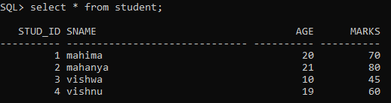

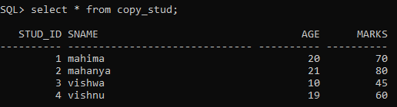
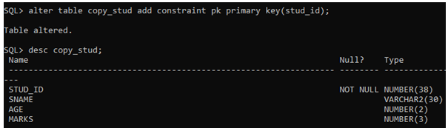

Slide 44

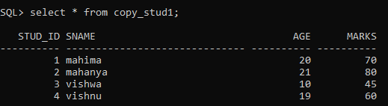
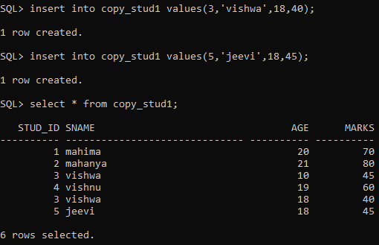

Slide 45


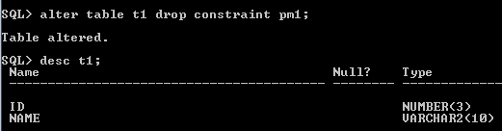

Slide 46





Slide 47
Enabling Constraints Upon Definition:
The following CREATE TABLE and ALTER TABLE statements both define and enable integrity constraints:
CREATE TABLE tablename (
columnname type CONSTRAINT constraintname PRIMARY KEY, . . . ;
ALTER TABLE tablename
ADD CONSTRAINT constraintname PRIMARY KEY (columnname);
Disabling Constraints Upon Definition
CREATE TABLE tablename (
columnname datatype PRIMARY KEY DISABLE, . . . ;
ALTER TABLE tablename
ADD PRIMARY KEY (columnname) DISABLE;

Slide 48
To disable constraint:
ALTER TABLE tablename DISABLE CONSTRAINT constraintname;
Eg SQL> alter table book disable constraint booid_pk;
Duplicate values inserted will be accepted.
To enable constraint:
ALTER TABLE tablename ENABLE CONSTRAINT constraintname;
Eg: SQL> alter table book enable constraint booid_pk;
Duplicate values inserted will not be accepted.
Primary key violation:
Entering the duplicate values, will violate the constraint.

Slide 49

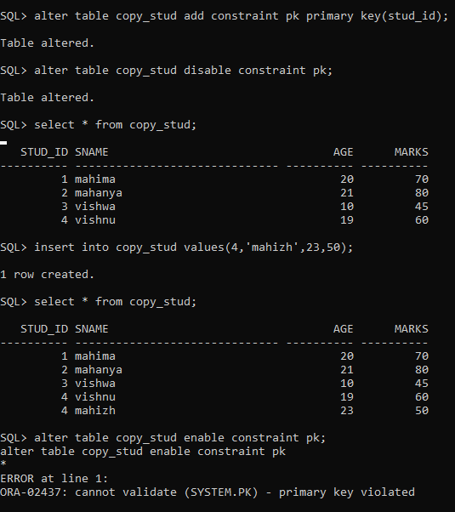

Slide 50
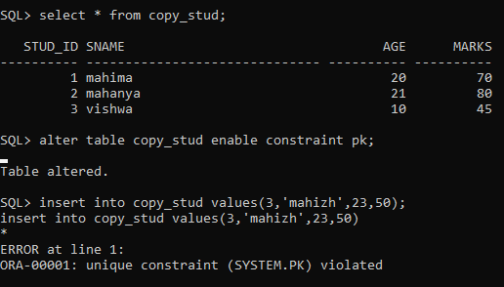

Slide 51
The following statements enable novalidate disabled integrity constraints:
Any existing data in the table is not checked.
A table with enable novalidated constraints can contain invalid data, but it is not possible to add new invalid data to it.
ALTER TABLE tablename
ENABLE NOVALIDATE CONSTRAINT constraintname;
ALTER TABLE tablename
ENABLE NOVALIDATE PRIMARY KEY,
ENABLE NOVALIDATE UNIQUE (column name1,..);
ALTER TABLE tablename
MODIFY PRIMARY KEY ENABLE NOVALIDATE;
The following statements enable or validate disabled integrity constraints:
ALTER TABLE tablename
MODIFY CONSTRAINT constraintname VALIDATE;

Slide 52
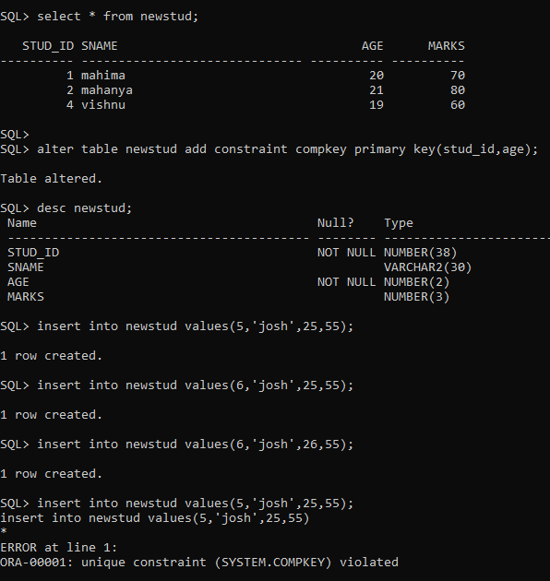
Composite key

Slide 53
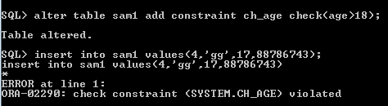
check
Used to limit the value range in the column.
In Create:
Create table emp(
eid number(5),
ename varchar2(30),
gender char(1) constraint ch_gn check(gender in ‘M’,’F’),
age int constraint ch_ag check(age>18));
To drop:
Alter table emp drop constraint ch-gn;
In alter:
Alter table emp add constraint ch_gn check(gender in..);

Slide 54
Unique
A unique constraint is a single field or combination of fields that uniquely defines a record.
It accept null values.
Note: Oracle does not permit to create both a primary key and unique constraint on the same column.
Syntax to define a Unique key at column level:
[CONSTRAINT constraint_name] UNIQUE
Syntax to define a Unique key at table level:
[CONSTRAINT constraint_name] UNIQUE(column_name)
Using a CREATE TABLE statement:
The syntax for creating a unique constraint using a CREATE TABLE statement is:
CREATE TABLE table_name ( column1 datatype null/not null, column2 datatype null/not null, ... CONSTRAINT constraint_name UNIQUE (column1, column2, . column_n) );

Slide 55
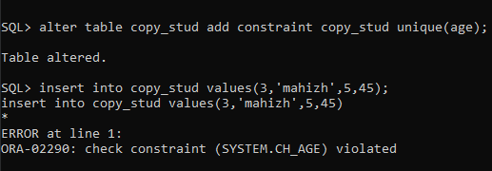
For Example
CREATE TABLE supplier (
supplier_id numeric(10) ,
supplier_name varchar2(50) not null,
contact_name varchar2(50),
CONSTRAINT supplier_unique UNIQUE (supplier_id) );
Or
Alter table supplier add constraint supplier unique(supplier_id);
Alter table supplier disable constraint supplier_id;
Alter table supplier enable constraint supplier_id;

Slide 56
default
To provide default values for the column.
Eg:
Table name: student
Attributes: srno,sname,age,dept
Create table student(srno int,sname varchar2(30), age int,dept varchar2(30) default ‘mca’);
Alter table student modify(dept default ‘mca’);
Insert into student(srno,sname)values(1,’aa’);

Slide 57
Foreign key or referential integrity
A foreign key is a column in a table that does NOT uniquely identify rows in that table, but is used as a link to matching columns in other tables to indicate a relationship .
It establishes a relationship between two columns in the same table or between different tables.
For a column to be defined as a Foreign Key, it should be a defined as a Primary Key in the table which it is referring.
One or more columns can be defined as Foreign key.
Define a table with primary key to reference:
CREATE TABLE t1 (c1 NUMBER PRIMARY KEY);
Inline foreign key (part of column definition):
CREATE TABLE t2 ( c1 NUMBER PRIMARY KEY, c2 NUMBER REFERENCES t1(c1) );
Syntax to define a Foreign key at column level:
[CONSTRAINT constraint_name] REFERENCES Referenced_Table_name(column_name)
Out-of-line foreign key (after column definitions):
CREATE TABLE t3 ( c1 NUMBER, c2 NUMBER, CONSTRAINT t1_fk FOREIGN KEY (c1) REFERENCES t1);
Syntax to define a Foreign key at table level:
[CONSTRAINT constraint_name] FOREIGN KEY(column_name) REFERENCES referenced_table_name(column_name);

Slide 58
Foreign Key at column level:
CREATE TABLE product ( product_id number(5) CONSTRAINT pd_id_pk PRIMARY KEY, product_name char(20), supplier_name char(20), unit_price number(10) );
CREATE TABLE order_items ( order_id number(5) CONSTRAINT od_id_pk PRIMARY KEY, product_id number(5) CONSTRAINT pd_id_fk REFERENCES, product(product_id), product_name char(20), supplier_name char(20), unit_price number(10) );
Foreign Key at table level:
CREATE TABLE order_items ( order_id number(5) , product_id number(5), product_name char(20), supplier_name char(20), unit_price number(10) CONSTRAINT od_id_pk PRIMARY KEY(order_id), CONSTRAINT pd_id_fk FOREIGN KEY(product_id) REFERENCES product(product_id) );

Slide 59

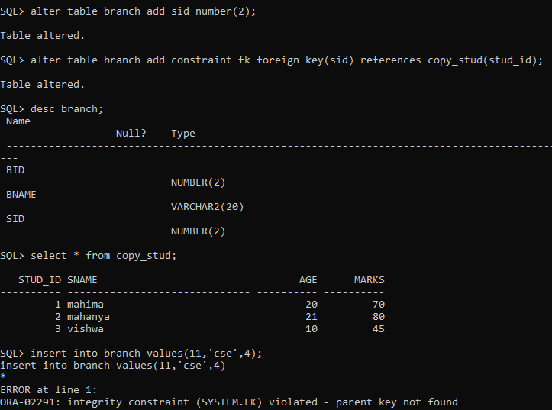

Slide 60
Can a non-primary key be a foreign key in another table?
Yes, a foreign key can reference a non-primary key which is unique. A FOREIGN KEY constraint does not have to be linked only to a PRIMARY KEY constraint in another table; it can also be defined to reference the columns of a UNIQUE constraint in another table.

Slide 61
Not null
This constraint ensures all rows in the table contain a definite value for the column which is specified as not null. Which means a null value is not allowed.
Syntax to define a Not Null constraint:
[CONSTRAINT constraint name] NOT NULL
For Example:
CREATE TABLE employee ( id number(5), name char(20) CONSTRAINT nm_nn NOT NULL, dept char(10), age number(2), salary number(10), location char(10) );
ALTER TABLE employee MODIFY ( name NOT NULL);
alter table employee add constraint nn1 check (name is not null);

Slide 62
Create table t1(id number(10) not null, name varchar2(30));
Insert into t1(&id,’&name’);
Id :1
Name : aa
/
Id :2
Name : bb
/
Id :
Name : aa
/
Id : ‘a’
Name : ss
/
Id : ‘’
Name : vv
Note down the error msg for the above statements

Slide 63
NULL
Accept null values for the columns
If integer – ‘’(use empty single quotes)
If char – no need of quotes, just press enter
Create table t1(id number(10) null, name varchar2(30));
Insert into….
Id:1
Name : aa
/
Id : 2
Name : bb
/
Id :
Name : cc
/
Id:’’
Name : dd
/

Slide 64
SQL> alter table tt1 modify constraint id_pk validate;
alter table tt1 modify constraint id_pk validate
*
ERROR at line 1:
ORA-02437: cannot validate (SYSTEM.ID_PK) - primary key violated
SQL> alter table tt1 modify constraint id_pk novalidate ;
Table altered.

Slide 65
Dual table
The DUAL table is a special one-column table present by default in all Oracle database.
It is suitable for use in selecting a pseudocolumn such as SYSDATE or USER.
The table has a single VARCHAR2(1) column called DUMMY that has a value of 'X'.
The dual table is useful when a value must be returned only once, for example, the current date and time. All database users have access to DUAL.
Examples:
SELECT 1+1 FROM DUAL;
SELECT 1 FROM DUAL;
SELECT USER FROM DUAL;
SELECT SYSDATE FROM dual;

Slide 66
SQL> create table dual2 as select * from dual;
Table created.
SQL> desc dual2;
Name Null? Type
----------------------------------------- -------- ---------------------------
DUMMY VARCHAR2(1)
SQL> select count(*) from dual2;
COUNT(*)
----------
1

Slide 67
DQL
SELECT:
Select operators:
between and
not between and
like ‘a%’
not in (‘11’,’12’)
Distinct
all
Is not null
Is null
Logical operators:
and, or, not,
Relational operators:
=, !=(<>,^=), <=,etc
Arithmetic operators:
+,-,/,*
Set operators:
union, union all, intersect, intersect all, minus
Join operator : +

Slide 68
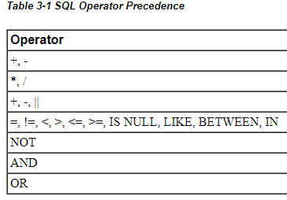
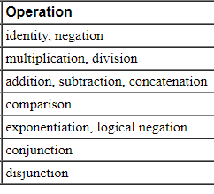
Precedence
Precedence is the order in which Oracle evaluates different operators in the same
expression.
In the following expression multiplication has a higher precedence than addition, so Oracle first multiplies 2 by 3 and then adds the result to 1.
1+2*3

Slide 69

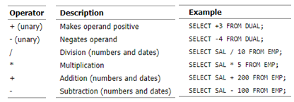
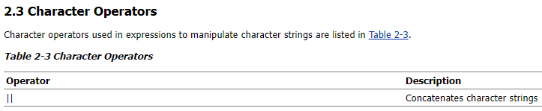
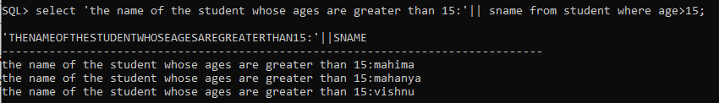

Slide 70

The <=> operator is equivalent to the standard SQL IS NOT DISTINCT FROM operator.
SELECT 'TRUE' FROM emp WHERE deptno NOT IN (5,15);
However, the following statement returns no rows:
SELECT 'TRUE' FROM emp WHERE deptno NOT IN (5,15,null);
The above example returns no rows because the WHERE clause condition evaluates to:
deptno != 5 AND deptno != 15 AND deptno != null

Slide 71



Slide 72
LIKE operator, used to compare a value to a pattern rather than to a constant.
The pattern can only appear after the LIKE keyword.
For example, you can issue the following query to find the salaries of all employees with names beginning with 'SM':
SELECT sal FROM emp WHERE ename LIKE 'SM%';
The following query uses the = operator, rather than the LIKE operator, to find the salaries of all employees with the name 'SM%':
SELECT sal FROM emp WHERE ename = 'SM%';
The following query finds the salaries of all employees with the name 'SM%'. Oracle interprets 'SM%' as a text literal, rather than as a pattern, because it precedes the LIKE operator:
SELECT sal FROM emp WHERE 'SM%' LIKE ename;
Patterns usually use special characters that Oracle matches with different characters in the value:
An underscore (_) in the pattern matches exactly one character in the value.
A percent sign (%) in the pattern can match zero or more characters in the value. Note that the pattern '%' cannot match a null.

Slide 73
Case Sensitivity and Pattern Matching
Case is significant in all conditions comparing character expressions including the LIKE and equality (=) operators. You can use the UPPER() function to perform a case-insensitive match, as in this condition:
UPPER(ename) LIKE 'SM%'
Pattern Matching on Indexed Columns
When LIKE is used to search an indexed column for a pattern, Oracle can use the index to improve the statement's performance if the leading character in the pattern is not "%" or "_". In this case, Oracle can scan the index by this leading character. If the first character in the pattern is "%" or "_", the index cannot improve the query's performance because Oracle cannot scan the index.
Example 1
This condition is true for all ENAME values beginning with "MA":
ename LIKE 'MA%'
All of these ENAME values make the condition TRUE: MARTIN, MA, MARK, MARY
Case is significant, so ENAME values beginning with "Ma," "ma," and "mA" make the condition FALSE.
Example 2
Consider this condition:
ename LIKE 'SMITH_'
This condition is true for these ENAME values: SMITHE, SMITHY, SMITHS
This condition is false for 'SMITH', since the special character "_" must match exactly one character of the ENAME value.

Slide 74
If you perform a text match on the actual underscore(_) or percent(%) characters, you can use the ESCAPE option.
If the escape character appears in the pattern before the character "%" or "_" then Oracle interprets this character literally in the pattern, rather than as a special pattern matching character.
Example:
To search for any employees with the pattern 'A_B' in their name:
SELECT ename FROM emp WHERE ename LIKE '%A\_B%' ESCAPE '\';
The ESCAPE option identifies the backslash (\) as the escape character. In the pattern, the escape character precedes the underscore (_). This causes Oracle to interpret the underscore literally, rather than as a special pattern matching character.

Slide 75


Logical Operators:
A logical operator combines the results of two component conditions to produce a single result based on them
For example, in the WHERE clause of the following SELECT statement, the AND logical operator is used to ensure that only those hired before 1984 and earning more than $1000 a month are returned:
SELECT * FROM emp WHERE hiredate < TO_DATE('01-JAN-1984', 'DD-MON-YYYY') AND sal > 1000;

Slide 76






Slide 77


Slide 78
Joining string values with column data from tables(concatenating string):
SQL> select 'supplier id '||sid||' have supplier name as '||supname from supplier;
'SUPPLIERID'||SID||'HAVESUPPLIERNAMEAS'||SUPNAME
--------------------------------------------------------------------------------
supplier id 1 have supplier name as aa
supplier id 2 have supplier name as gg
supplier id 6 have supplier name as ff
supplier id 4 have supplier name as jj
supplier id 10 have supplier name as ee

Slide 79
Clause:
order by(default is ascending-asc. For descending-desc).
SQL> select * from product order by pname;
SQL> select * from product order by pname desc;
group by
group by having
Set operators☹ (nested queries)
union, intersect, union all, minus
Rowid:
Aliases name for table:
Using more than one tables

Slide 80
SQL ORDER BY
The ORDER BY clause is used in a SELECT statement to sort results either in ascending or descending order.
Oracle sorts query results in ascending order by default.
Syntax for using SQL ORDER BY clause to sort data is:
SELECT column-list FROM table_name [WHERE condition] [ORDER BY column1 [, column2, .. columnN] [DESC]];
Example: Query to sort the employee table by salary of the employee, the sql query would be.
SELECT name, salary FROM employee ORDER BY salary;
Orderby two columns:
SELECT name, salary FROM employee ORDER BY name, salary;
NOTE:The columns specified in ORDER BY clause should be one of the columns selected in the SELECT column list.

Slide 81
Can also represent the columns in the ORDER BY clause by specifying the position of a column in the SELECT list, instead of writing the column name.
SELECT name, salary FROM employee ORDER BY 1, 2;
SELECT name, salary FROM employee ORDER BY name, salary DESC;
The above query sorts only the column 'salary' in descending order and the column 'name' by ascending order.

Slide 82
Using expressions in the ORDER BY Clause
Expressions in the ORDER BY clause of a SELECT statement.
For example: If you want to display employee name, current salary, and a 20% increase in the salary for only those employees for whom the percentage increase in salary is greater than 30000 and in descending order of the increased price, the SELECT statement can be written as shown below
SELECT name, salary, salary*0.2 AS new_salary FROM employee WHERE salary*0.2 > 30000 ORDER BY new_salary DESC;
NOTE:Aliases defined in the SELECT Statement can be used in ORDER BY Clause.

Slide 83
SQL> select eid,ename from emp order by eid;
EID ENAME
------- ----------------
1 aa
2 bb
3 cc
4 dd
5 ee
6 aa
8 ff
10 ww
8 rows selected.
SQL> select eid,ename from emp order by eid,ename;
EID ENAME
---------- ---------------
1 aa
2 bb
3 cc
4 dd
5 ee
6 aa
8 ff
10 ww
8 rows selected.

Slide 84
SQL> select eid,ename from emp order by eid desc,ename desc;
EID ENAME
---------- ------------------------------
10 ww
8 ff
6 aa
5 ee
4 dd
3 cc
2 bb
1 aa
SQL> select eid,ename from emp order by ename desc,eid desc;
EID ENAME
---------- ------------------------------
10 ww
8 ff
5 ee
4 dd
3 cc
2 bb
6 aa
1 aa
8 rows selected.
SQL> select eid,ename from emp order by ename desc;
EID ENAME
---------- ------------------------------
10 ww
8 ff
5 ee
4 dd
3 cc
2 bb
1 aa
6 aa

Slide 85
SQL GROUP BY Clause:
The SQL GROUP BY Clause is used along with the group functions to retrieve data grouped according to one or more columns.
Example: Query to get the total amount of salary spent on each department
SELECT dept, SUM (salary) FROM employee GROUP BY dept;
NOTE: The group by clause should contain all the columns in the select list expect those used along with the group functions.
SELECT location, dept, SUM (salary) FROM employee GROUP BY location, dept;

Slide 86
SQL HAVING Clause
Having clause is used to filter data based on the group functions.
This is similar to WHERE condition but is used with group functions.
Group functions cannot be used in WHERE Clause but can be used in HAVING clause.
To select the department that has total salary paid for its employees more than 25000, the sql query would be like;
SELECT dept, SUM (salary) FROM employee GROUP BY dept HAVING SUM (salary) > 25000
SQL> select * from kecstud where sum(age)>200;
select * from kecstud where sum(age)>200
*
ERROR at line 1:
ORA-00934: group function is not allowed here
When WHERE, GROUP BY and HAVING clauses are used together in a SELECT statement, the WHERE clause is processed first, then the rows that are returned after the WHERE clause is executed are grouped based on the GROUP BY clause.
Finally, any conditions on the group functions in the HAVING clause are applied to the grouped rows before the final output is displayed

Slide 87
Find all the departments where more than ten employees are working.
Select deptname from employee group by deptname having count(eid)>10;

Slide 88
SubQueries
A subquery is a query within a query.
Can be used in DQL & DML statements.
These subqueries can reside in the WHERE clause, the FROM clause, or the SELECT clause, HAVING clause.
Alternative way of returning data from multiple tables.
Types of subqueries:
Single row – returning zero or one row (comparison operators, logical etc)
Multiple row –returning one or more rows.(group functions,comparison operators like IN,ANY,EXIXTS,NOT EXISTS,NOT IN,ALL etc).
Rules:
Enclosed within paranthesis.
Can be used in groupby.
Cannot be used in orderby.
Can’t use between.

Slide 89
WHERE clause
Most often, the subquery will be found in the WHERE clause. These subqueries are also called nested subqueries.
Correlated query:
Correlated sub query is used for row by row processing. The sub query is executed for each row of the main query.
so called ,because the subquery references the outer query in the subqueries WHERE clause.
Internally, correlated subqueries are very expensive to process because the inner query must be executed for every row returned by the outer query.
Oracle allows up to 255 levels of subqueries in the WHERE clause.
FROM clause
A subquery can also be found in the FROM clause. These are called inline views(subselect). Also called derived tables.
Unlimited levels of subqueries are allowed.
SELECT column_list FROM ( SELECT * FROM table_name ) t;
SQL> select marks from (select * from kecmarks)t,kecstud s where t.sid=s.id;
MARKS
----------
60
80
45
90
87

Slide 90
Nested Subqueries Versus Correlated Subqueries :
With a normal nested subquery, the inner SELECT query runs first and executes once, returning values to be used by the main query.
A correlated subquery, however, executes once for each candidate row considered by the outer query. In other words, the inner query is driven by the outer query.
NOTE: You can also use the ANY and ALL operator in a correlated subquery.

Slide 91
SQL: Where column > (subquery)
The following subquery selects those employees whose salary is greater than the minimum salary for their jobs.
Combining two tables:
select emp_last_name from emp where emp_salary > (select job_min_sal from job where emp.job_key = job.job_key) ;
With in the same table:
Find the employee name who is getting lowest salary.
Select ename,salary from employee where salary=(select min(salary) from employee);
Get the details of course that has highest course fee.
select ccode,name,fee from courses where fee =(select max(fee) from courses);

Slide 92
1. Write a query to find the salary of employees whose salary is greater than the salary of employee whose id is 100? SELECT EMPLOYEE_ID, SALARY FROM EMPLOYEES WHERE SALARY > ( SELECT SALARY FROM EMPLOYEES WHERE EMPLOYEED_ID = 100 );
Write a query to find the employees who all are earning the highest salary? SELECT EMPLOYEE_ID, SALARY FROM EMPLOYEES WHERE SALARY = ( SELECT MAX(SALARY) FROM EMPLOYEES );
Write a query to find the departments in which the least salary is greater than the highest salary in the department of id 200? SELECT DEPARTMENT_ID, MIN(SALARY) FROM EMPLOYEES GROUP BY DEPARTMENT_ID HAVING MIN(SALARY) > ( SELECT MAX(SALARY) FROM EMPLOYEES WHERE DEPARTMENT_ID = 200 ) ;

Slide 93
1. Write a query to find the employees whose salary is equal to the salary of at least one employee in department of id 300? SELECT EMPLOYEE_ID, SALARY FROM EMPLOYEES WHERE SALARY IN ( SELECT SALARY FROM EMPLOYEES WHERE DEPARTMENT_ID = 300 ) 2. Write a query to find the employees whose salary is greater than at least on employee in department of id 500? SELECT EMPLOYEE_ID, SALARY FROM EMPLOYEES WHERE SALARY > ANY ( SELECT SALARY FROM EMPLOYEES WHERE DEPARTMENT_ID = 500 ) 3. Write a query to find the employees whose salary is less than the salary of all employees in department of id 100? SELECT EMPLOYEE_ID, SALARY FROM EMPLOYEES WHERE SALARY < ALL ( SELECT SALARY FROM EMPLOYEES WHERE DEPARTMENT_ID = 100 ) 4. Write a query to find the employees whose manager and department should match with the employee of id 20 or 30? SELECT EMPLOYEE_ID, MANAGER_ID, DEPARTMENT_ID FROM EMPLOYEES WHERE (MANAGER_ID,DEPARTMENT_ID) IN ( SELECT MANAGER_ID, DEPARTMENT_ID FROM EMPLOYEES WHERE EMPLOYEE_ID IN (20,30) ) 5. Write a query to get the department name of an employee? SELECT EMPLOYEE_ID, DEPARTMENT_ID, (SELECT DEPARTMENT_NAME FROM DEPARTMENTS D WHERE D.DEPARTMENT_ID = E.DEPARTMENT_ID ) FROM EMPLOYEES E

Slide 94
Correlated sub query is used for row by row processing. The sub query is executed for each row of the main query. 1. Write a query to find the highest earning employee in each department? SELECT DEPARTMENT_ID, EMPLOYEE_ID, SALARY FROM EMPLOYEES E_0 WHERE 1 = ( SELECT COUNT(DISTINCT SALARY) FROM EMPLOYEES E_I WHERE E_O.DEPARTMENT_ID = E_I.DEPARTMENT_ID AND E_O.SALARY <= E_I.SALARY ) ;
2. Write a query to list the department names which have at lease one employee? SELECT DEPARTMENT_ID, DEPARTMENT_NAME FROM DEPARTMENTS D WHERE EXISTS ( SELECT 1 FROM EMPLOYEES E WHERE E.DEPARTMENT_ID = D.DEPARTMENT_ID) ;
3. Write a query to find the departments which do not have employees at all? SELECT DEPARTMENT_ID, DEPARTMENT_NAME FROM DEPARTMENTS D WHERE NOT EXISTS ( SELECT 1 FROM EMPLOYEES E WHERE E.DEPARTMENT_ID = D.DEPARTMENT_ID)

Slide 95
In select
Select min(salary) from employee;
Select name, min(salary) from employee;
Select name from employee where salary in (select min(salary) from employee);
Select * from employee where eid in(select eid from salary where sal>15000);
Select * from employee where eid in (select eid from salary where sal in (select sal from expense where sal>15000);
Select eid, ename, (select sal from expense where sal=15000) from employee;
Select * from employee where eid in (select eid from salary where sal>10000 and sal in(select sal from salary where sal <50000));

Slide 96
In Insert statement:
SQL> insert into sammark select * from kecmarks where sid>1;
4 rows created.
SQL> insert into tt2 select * from tt1;
5 rows created.
Insert into employee select * from customer where id in (select id from customer);
Insert into employee(eid,ename) select(eid,ename) from customer where eid in (select eid from expense where sal>15000);
In update statement:
Update employee set sal=salary*0.50 where exp in(select exp from employee where exp>25);
In delete:
Delete from employee where exp in(select exp from employee where exp<1);
SQL> delete from tt1 where salary in(select salary from tt1 where salary=70000);
2 rows deleted.

Slide 97
SQL> create table tt1 (id number,name varchar2(30),salary number);
Table created.
SQL> create table tt2(id number,name varchar2(30),salary number);
Table created.
SQL> insert into tt2 select * from tt1;
4 rows created.
SQL> insert into tt1 select * from tt2 where salary>40000;
1 row created.
SQL> insert into tt1(id,name) select id,name from tt2 where salary=70000;
1 row created.
SQL> insert into tt1(id,name) select id,name from tt2 where salary in(select sal
ary from tt2 where salary=70000);
1 row created.

Slide 98
An EXISTS condition tests for existence of rows in a subquery. If at least one row returns, it will evaluate as TRUE.
NOT EXISTS evaluates as TRUE if 0 rows are returned and can be used to validate the absence of a condition.
Where exists (subquery) The WHERE EXISTS subquery is used when we want to display all rows where we have a matching column in both tables.
In most cases, this type of subquery can be re-written with a standard join to improve performance.
select book_key from book where exists (select book_key from sales) ;
Where not exists (subquery) The WHERE NOT EXISTS subquery is used to display cases where a selected column does not appear in another table.
select author_key from author where not exists (select author_key from book_author) ;
As a general rule, the use of the NOT EXISTS subqueries are discouraged because the query can often be re-written as a standard join with much faster performance.
Where column in (subquery)
select book_title from book where pub_key in (select pub_key from publisher where publisher.pub_key = book.pub_key) ;

Slide 99



Slide 100


Slide 101
joins
SQL Joins are used to relate information in different tables.
A Join condition is a part of the sql query that retrieves rows from two or more tables.
A SQL Join condition is used in the SQL WHERE Clause of select, update, delete statements.
The Syntax for joining two tables is:
SELECT col1, col2, col3... FROM table_name1, table_name2 WHERE table_name1.col2 = table_name2.col1;
Types of SQL joins:
Self join
SQL INNER JOIN (or sometimes called simple join)
Equi join
Non equi join
Natural join – inner/equi & outer
Outer join
SQL LEFT OUTER JOIN (or sometimes called LEFT JOIN)
SQL RIGHT OUTER JOIN (or sometimes called RIGHT JOIN)
SQL FULL OUTER JOIN (or sometimes called FULL JOIN)
Cartesian join or cross join
Note: join is inner by default.

Slide 102
EQUI-JOIN It is a simple sql join condition which uses the equal sign(=) as the comparison operator. Two types of equi joins are SQL Outer join and SQL Inner join.
NON-EQUI JOIN It is a sql join condition which makes use of some comparison operator other than the equal sign like >, <, >=, <=
SELF JOIN Self join is a join type between a row of a table to another row of the same table.
OUTER JOIN This type fetches the row that matches the join condition and rows that don’t match the join condition.
Simple JOIN
SELECT p.last_name, t.deptName FROM person p, dept t WHERE p.id = t.id;
Find name and department name of students who have been allotted a department
Inner/Equi/Natural JOIN
SELECT * from Emp INNER JOIN Dept on Emp.empid=Dept.empid
Extracts data that meets the JOIN conditions only.
Outer Join
SELECT distinct * from Emp LEFT OUTER JOIN Dept Where Emp.empid=Dept.empid
It includes non matching rows also unlike Inner Join.
Self JOIN
SELECT a.name,b.name from emp a, emp b WHERE a.id=b.rollNumber
Joining a Table to itself.
A Cartesian join or Cartesian product is a join of every row of one table to every row of another table. This normally happens when no matching join columns are specified. For example, if table A with 100 rows is joined with table B with 1000 rows, a Cartesian join will return 100,000 rows.
SELECT * FROM emp CROSS JOIN dept;

Slide 103
SQL> select * from supplier natural inner join order1;
SID SUPNAME OID ODATE
---------- ------------------------------ ---------- ---------
4 jj 1 12-FEB-14
10 ee 2 13-JAN-14
SQL> select * from supplier s inner join order1 o on s.sid=o.sid;
SID SUPNAME OID SID ODATE
---------- ------------------------------ ---------- ---------- ---------
4 jj 1 4 12-FEB-14
10 ee 2 10 13-JAN-14

Slide 104
Consider two tables with fields as follows:
SQL> select * from supplier;
SID SUPNAME
---------- ------------------------------
1 aa
2 gg
6 ff
4 jj
10 ee
SQL> select * from order1;
OID SID ODATE
---------- ---------- ---------
1 4 12-FEB-14
2 10 13-JAN-14
3 11 20-DEC-14

Slide 105
SQL INNER JOIN (simple join)
It is the most common type of SQL join.
SQL INNER JOINS return all rows from multiple tables where the join condition is met.
SQL INNER JOIN Syntax
SELECT columns FROM table1 INNER JOIN table2 ON table1.column = table2.column;
SQL> select s.supname,o.oid,o.odate from supplier s inner join order1 o on s.sid =o.sid;
Or
select s.supname,o.oid,o.odate from supplier s ,order1 o where s.sid =o.sid;
SUPNAME OID ODATE
------------------------------ ---------- ---------
jj 1 12-FEB-14
ee 2 13-JAN-14

Slide 106
SQL LEFT OUTER JOIN
This type of join returns all rows from the LEFT-hand table specified in the ON condition and only those rows from the other table where the joined fields are equal (join condition is met).
SQL LEFT OUTER JOIN Syntax
SELECT columns FROM table1 LEFT [OUTER] JOIN table2 ON table1.column = table2.column;In some databases, the LEFT OUTER JOIN keywords are replaced with LEFT JOIN.
SQL> select s.supname,o.oid,o.odate from supplier s left outer join order1 o on s.sid=o.sid;
SUPNAME OID ODATE
------------------------------ ---------- ---------
jj 1 12-FEB-14
ee 2 13-JAN-14
ff
aa
gg (or)
SQL> select s.supname,o.oid,o.odate from supplier s, order1 o where s.sid=o.sid(+);
SUPNAME OID ODATE
------------------------------ ---------- ---------
jj 1 12-FEB-14
ee 2 13-JAN-14
ff
aa
gg

Slide 107
SQL RIGHT OUTER JOIN:
This type of join returns all rows from the RIGHT-hand table specified in the ON condition and only those rows from the other table where the joined fields are equal (join condition is met).
SQL RIGHT OUTER JOIN Syntax
SELECT columns FROM table1 RIGHT [OUTER] JOIN table2 ON table1.column = table2.column;
SQL> select s.supname,o.oid,o.odate from supplier s right outer join order1 o on s.sid=o.sid;
(or)
SELECT orders.order_id, orders.order_date, suppliers.supplier_name FROM suppliers, orders WHERE suppliers.supplier_id(+) = orders.supplier_id;
SUPNAME OID ODATE
------------------------------ ---------- ---------
jj 1 12-FEB-14
ee 2 13-JAN-14
3 20-DEC-14

Slide 108
SQL FULL OUTER JOIN
Another type of join is called a SQL FULL OUTER JOIN. This type of join returns all rows from the LEFT-hand table and RIGHT-hand table with nulls in place where the join condition is not met.
SQL FULL OUTER JOIN Syntax
SELECT columns FROM table1 FULL [OUTER] JOIN table2 ON table1.column = table2.column;
SQL> select s.supname,o.oid,o.odate from supplier s full outer join order1 o on
s.sid=o.sid;
SUPNAME OID ODATE
------------------------------ ---------- ---------
jj 1 12-FEB-14
ee 2 13-JAN-14
ff
aa
gg
3 20-DEC-14
6 rows selected.

Slide 109
SQL> create table emp(eid number, name varchar2(30));
Table created.
SQL> create table dept(eid number, dname varchar2(30));
Table created.
SQL> select * from emp;
EID NAME
---------- ------------------------------
1 akshith
2 dhanvanth
3 shivaani
4 ananya
SQL> select * from dept;
EID DNAME
---------- ------------------------------
1 mca
3 mba
4 it
6 cse
Self Join:
SQL> select e.eid,e1.name from emp e,emp e1 where e.eid=e1.eid;
EID NAME
---------- ------------------------------
1 akshith
2 dhanvanth
3 shivaani
4 ananya

Slide 110
Inner join:
have to specify condition
SQL> select eid,name,dname from emp inner join dept;
select eid,name,dname from emp inner join dept
*ERROR at line 1:
ORA-00905: missing keyword
SQL> select e.eid,e.name,d.dname from emp e inner join dept d on e.eid=d.eid;
EID NAME DNAME
---------- ------------------------------ ------------------------------
1 akshith mca
3 shivaani mba
4 ananya it
Natural inner join:
By default it check for equivality, so there is no need to specify any condition.
SQL> select eid,name,dname from emp natural inner join dept ;
EID NAME DNAME
---------- ------------------------------ ---------------------------
1 akshith mca
3 shivaani mba
4 ananya it

Slide 111
SQL> select * from emp natural inner join dept;
EID NAME DNAME
---------- ------------------------------ ----------------------------
1 akshith mca
3 shivaani mba
4 ananya it
SQL> select e.eid,e.name,d.dname from emp e natural inner join dept d on e.eid=d.eid;
select e.eid,e.name,d.dname from emp e natural inner join dept d on e.eid=d.eid
*
ERROR at line 1:
ORA-00933: SQL command not properly ended
SQL> select e.eid,e.name,d.dname from emp e natural inner join dept d;
select e.eid,e.name,d.dname from emp e natural inner join dept d
*
ERROR at line 1:
ORA-25155: column used in NATURAL join cannot have qualifier

Slide 112
SQL> select * from emp natural inner join dept;
EID NAME DNAME
---------- ------------------------------ ---------------------
1 akshith mca
3 shivaani mba
4 ananya it
SQL> select * from emp natural join dept;
EID NAME DNAME
---------- ------------------------------ ---------------------
1 akshith mca
3 shivaani mba
4 ananya it
SQL> select * from emp inner join dept;
select * from emp inner join dept
*ERROR at line 1:
ORA-00905: missing keyword
SQL> select * from emp e inner join dept d on e.eid=d.eid;
EID NAME EID DNAME
--------- ------------------------------ ----------------------------------------
1 akshith 1 mca
3 shivaani 3 mba
4 ananya 4 it

Slide 113
Cross join or Cartesian product:
SQL> select * from emp cross join dept;
Equi-Join:
SQL> select * from emp e join dept d on e.eid=d.eid;
EID NAME EID DNAME
---------- ------------------------------ -----------
1 akshith 1 mca
3 shivaani 3 mba
4 ananya 4 it
Non-Equi-Join:
SQL> select e.eid,e.name,d.dname from emp e join dept d on e.eid between 2 and 3;
EID NAME DNAME
---------- ------------------------------ ------------------------------
2 dhanvanth mca
2 dhanvanth mba
2 dhanvanth it
2 dhanvanth cse
3 shivaani mca
3 shivaani mba
3 shivaani it
3 shivaani cse
8 rows selected.

Slide 114
Left Outer Join/left join:
SQL> select e.eid from emp e left join dept d on e.eid=d.eid;
EID
----------
1
3
4
2
natural
SQL> select * from emp natural left join dept;
EID NAME DNAME
---------- --------------------------
1 akshith mca
3 shivaani mba
4 ananya it
2 dhanvanth

Slide 115
SQL>SQL> select * from emp natural right join dept;
EID NAME DNAME
---------- ------------------------------ -----------------
1 akshith mca
3 shivaani mba
4 ananya it
6 cse
SQL> select e.eid from emp e right outer join dept d on e.eid=d.eid;
EID
----------
1
3
4
SQL> select d.eid from emp e right outer join dept d on e.eid=d.eid;
EID
----------
1
3
4
6

Slide 116
SQL> select * from emp natural full join dept;
EID NAME DNAME
---------- --------------------------
1 akshith mca
3 shivaani mba
4 ananya it
2 dhanvanth
6 cse
SQL> select * from emp e full outer join dept d on e.eid=d.eid;
EID NAME EID DNAME
---------- ------------------------------ -------------
1 akshith 1 mca
3 shivaani 3 mba
4 ananya 4 it
2 dhanvanth
6 cse

Slide 117
Set operators
Combine 2 or more select statements
UNION ALL
UNION
MINUS
INTERSECT
SQL statements containing these set operators are referred to as compound queries
Each SELECT statement in a compound query is referred to as a component query.
Two SELECTs can be combined into a compound query by a set operation only if they satisfy the following two conditions:
The result sets of both the queries must have the same number of columns.
The datatype of each column in the second result set must match the datatype of its corresponding column in the first result set.
The generic syntax of a query involving a set operation is:
<component query> {UNION | UNION ALL | MINUS | INTERSECT} <component query>

Slide 118
TIP: The datatypes do not need to be the same if those in the second result set can be automatically converted by Oracle (using implicit casting) to types compatible with those in the first result set.
These conditions are also referred to as union compatibility conditions.
Set operations are often called vertical joins, because the result combines data from two or more SELECTS based on columns instead of rows.

Slide 119
SQL> select * from t1;
ID SID NAME
---------- ---------- ------------------------------
1 1 aa
2 2 as
3 4 sd
2 4 sd
6 6 dd
2 3
6 rows selected.
SQL> select * from t2;
ID NAME
---------- ------------------------------
2 dd
1 ee
3 dd
5 jj
gg
6
6 rows selected.

Slide 120
SQL> select * from t1 union select * from t2;
select * from t1 union select * from t2
*
ERROR at line 1:
ORA-01789: query block has incorrect number of result columns
SQL> select id,name from t1 union select * from t2;
ID NAME
---------- ------------------------------
1 aa
1 ee
2 as
2 dd
2 sd
2
3 dd
3 sd
5 jj
6 dd
6
ID NAME
---------- ------------------------------
gg
12 rows selected.
SQL> select id,sid from t1 union select * from t2;
select id,sid from t1 union select * from t2
*
ERROR at line 1:
ORA-01790: expression must have same datatype as corresponding exp

Slide 121
SQL> select id,name from t1 union all select * from t2;
ID NAME
---------- ------------------------------
1 aa
2 as
3 sd
2 sd
6 dd
2
2 dd
1 ee
3 dd
5 jj
gg
ID NAME
---------- ------------------------------
6
12 rows selected.

Slide 122
SQL> select * from product;
PID PNAME QUAN PRICE
---------- ------------------------------ ---------- ----------
1 pen 100 2
2 pencil 200 10
3 marker 150 30
4 duster 100 25
5 notebook 50 20
6 sticker 150 10
7 pencil box 300 50
8 waterbottle 500 45
8 rows selected.
Select operators:
SQL> select * from product where price between 20 and 100;
PID PNAME QUAN PRICE
---------- ------------------------------ ---------- ----------
3 marker 150 30
4 duster 100 25
5 notebook 50 20
7 pencil box 300 50
8 waterbottle 500 45
SQL> select * from product where price not between 20 and 100;
PID PNAME QUAN PRICE
---------- ------------------------------ ---------- ----------
1 pen 100 2
2 pencil 200 10
6 sticker 150 10

Slide 123
SQL> select * from product where (price not between 20 and 100) and (quan not in
('100','200'));
PID PNAME QUAN PRICE
---------- ------------------------------ ---------- ----------
6 sticker 150 10
SQL> select * from product where (price not between 20 and 100) or (quan not in(
'100','200'));
PID PNAME QUAN PRICE
---------- ------------------------------ ---------- ----------
1 pen 100 2
2 pencil 200 10
3 marker 150 30
5 notebook 50 20
6 sticker 150 10
7 pencil box 300 50
8 waterbottle 500 45
7 rows selected.

Slide 124
SQL> select pid,pname from product where pname like'w%';
PID PNAME
---------- ------------------------------
8 waterbottle
SQL> select pname from product where quan like'_5_';
PNAME
------------------------------
marker
Sticker
SQL> select
2 pname from product where pname like'%n’;
PNAME
------------------------------
Pen
SQL> select * from A where pname like '%';

Slide 125
Arithmetic operators:
SQL> select pname,price*10 from product;
PNAME PRICE*10
------------------------------ ----------
pen 20
pencil 100
marker 300
duster 250
notebook 200
sticker 100
pencil box 500
waterbottle 450
8 rows selected.
SQL> select m1+m2+m3 "marks" from sample1;
marks
----------
150
155
157
89

Slide 127
Functions in oracle
Single row functions
Multirow functions
Numeric functions
Character functions returning character values
Character functions returning number values
String functions
Conversion functions
Datetime functions
Aggregate functions
Analytic functions
Encoding function
User and session functions
Cache grid functions LOB functions
NLS character set functions
General comparison functions
Null-related comparison functions

Slide 128
Numeric functions:
Numeric functions accept numeric input and return numeric values. The numeric functions are:
ABS ACOS ASIN ATAN ATAN2 BITAND CEIL COS COSH EXP FLOOR LN LOG MOD NANVL POWER REMAINDER ROUND (number) SIGN SIN SINH SQRT TAN TANH TRUNC (number) WIDTH_BUCKET

Slide 129
ABS:
SELECT ABS(-15) "Absolute" FROM DUAL; Absolute
----------
15
ACOS:
ACOS returns the arc cosine of n. The argument n must be in the range of -1 to 1, and the function returns a value in the range of 0 to pi, expressed in radians.
SELECT ACOS(.3)"Arc_Cosine" FROM DUAL;
Arc_Cosine
----------
1.26610367
ASIN:
ASIN returns the arc sine of n. The argument n must be in the range of -1 to 1, and the function returns a value in the range of -pi/2 to pi/2, expressed in radians.
SELECT ASIN(.3) "Arc_Sine" FROM DUAL;
Arc_Sine
----------
.304692654
ATAN:
ATAN returns the arc tangent of n. The argument n can be in an unbounded range and returns a value in the range of -pi/2 to pi/2, expressed in radians.
SELECT ATAN(.3) "Arc_Tangent" FROM DUAL;
Arc_Tangent
----------
.291456794

Slide 130
Ceil:
SQL> select ceil(3.5) from dual;
CEIL(3.5)
----------
4
SQL> select ceil(3.4) from dual;
CEIL(3.4)
----------
4
SQL> select ceil(3.0) from dual;
CEIL(3.0)
----------
3
SQL> select ceil(3.1) from dual;
CEIL(3.1)
----------
4
FLOOR:
SQL> select floor(2.1) from dual;
FLOOR(2.1)
----------
2
SQL> select floor(2.5) from dual;
FLOOR(2.5)
----------
2

Slide 131
Round:
SQL> select round(2.5) from dual;
ROUND(2.5)
----------
3
SQL> select round(2.1) from dual;
ROUND(2.1)
----------
2
SQL> select round(2.05) from dual;
ROUND(2.05)
-----------
2
SQL>

Slide 132
Global Temporary Tables (GTT)
Oracle introduced Global Temporary Tables (GTT) for removing complex subqueries and allowing us to materialize the intermediate data that we need to solve a complex problem with SQL.
Here is the same solution with Create Table As Select (CTAS)
create global temporary table store_qty on commit preserve rows as select sum(quantity) all_sales from sales;

Slide 133
Update student set snama=‘bb’ where rno=1;

Slide 134
Database objects

Slide 135
Database objects:View,Sequence,Synonym,index
Views:
A view is a named and validated SQL query which is stored in the Oracle data dictionary. Views do not contain any data - it is just a stored query in the database that can be executed when called. One can think of a view as a virtual table or mapping of data from one or more tables.
Necessary to prevent all users from accessing all columns of a table, for security reasons.
Achieved by creating separate tables having specific columns and assigning users for each tables. but it leads to redundant data.
To overcome the said problem:
to reduce redundant data to minimum possible, by creating view object.
View mapped to table ,have subset of actual coulmns of table.(this offers simple effective way of hiding columns of table).

Slide 136
Fact about view:
is stored only as definition in system catalog.
When a reference is made to view, its definition is scanned, the base table is opened and the view created on top of the base table.
It holds no data until the call is made to view.
Query on view run slower than query on base table because
1. view definition has to retrieved from catalog.
2.base table has to be identified and opened in memory.
3.then view has to be constructed on top of the base table. Then query execute.
Types of views:
read-only view :(views only for looking at table data.
Updateable view:(view for inserting, deleting, updating table data)

Slide 137
Creating view:
CREATE VIEW<viewname> AS SELECT<columnames> FROM <tablename> WHERE<condition> GROUP BY <grouping criteria> HAVING <predicate>;
Renaming columns in views:
CREATE VIEW<viewname> AS SELECT columnname alias name,…. FROM tablename.
Selecting from view:
SELECT <columnname…> FROM <viewname>;
Can insert, delete and update the view contents.
For view to be updateable the view definition must not include:
Aggregate function.
Distinct, group by or having clause
Sub queries
Constants,string or values expressions like ss*1.05;
Set operators
DROP views:
DROP VIEW <viewnmae>;

Slide 138
Read-only views:
Users can only run SELECT and DESC statements against read only views.
Example:
CREATE VIEW clerk (id_number, person, department, position) AS SELECT empno, ename, deptno, job FROM emp WHERE job = 'CLERK' WITH READ ONLY;
SQL> create view vv1 as select eid,dname from dept with read only;
View created.
SQL> desc vv1;
Name Null? Type
----------------------------------------- -------- --------------------
EID NUMBER
DNAME VARCHAR2(30)
SQL> select * from vv1;
EID DNAME
---------- ------------------------------
1 mca
3 mba
4 it
6 cse
1 ww
10 ak
6 rows selected.

Slide 139
SQL> insert into vv1 values(&eid,'&dname');
Enter value for eid: 1
Enter value for dname: aa
old 1: insert into vv1 values(&eid,'&dname')
new 1: insert into vv1 values(1,'aa')
insert into vv1 values(1,'aa')
*
ERROR at line 1:
ORA-01733: virtual column not allowed here
WITH CHECK OPTION
The WITH CHECK OPTION clause specifies the level of checking to be done when doing DML against the view. If specified, every row that is inserted, updated or deleted through the view must conform to the definition of the view.
Example:
CREATE VIEW d20 AS SELECT ename, sal, deptno FROM emp2 WHERE deptno = 20 2 WITH CHECK OPTION;
SQL> UPDATE d20 SET deptno = 10;
*ERROR at line 1:
ORA-01402: view WITH CHECK OPTION where-clause violation
Options to work:
Create view from base table
Create view from another view
View created from multiple tables
Constraints
Insert,delete, update values into view and check for whether this things reflected in it base table.

Slide 140
SEQUENCE:
A sequence is a database object that generates unique numbers, mostly used for primary key values.
Provides a sequential series of numbers.
Especially useful in multiuser environments for generating unique sequential numbers without the overhead of disk I/O or transaction locking.
Oracle stores the definitions of all sequences for a particular database as rows in a single data dictionary table in the SYSTEM tablespace. Therefore, all sequence definitions are always available, because the SYSTEM tablespace is always online
Sequence numbers are generated independently of tables. Therefore, the same sequence generator can be used for more than one table. Sequence number generation is useful to generate unique primary keys for your data automatically.
One can select the NEXTVAL and CURRVAL from a sequence. Selecting the NEXTVAL will automatically increment the sequence.

Slide 141

CREATE SEQUENCE sequencename

Slide 142
Parts:
INCREMENT BY:
specify the interval. positive or negative but not zero.
if positive, ascends. if negative, descends. default is 1.
START WITH:
Specify the first sequence number to be generated.
MAXVALUE:
MAXVALUE must be equal to or greater than START WITH and must be greater than MINVALUE.
NOMAXVALUE : 1027 for ascending. -1 for descending (default)
MINVALUE:MINVALUE must be less than or equal to START WITH and must be less than MAXVALUE.
NOMINVALUE: minimum value of 1 for an ascending sequence or -10²⁶ for a descending sequence.(default)
CYCLE : sequence continues to generate values after reaching either its maximum or minimum value.
NOCYCLE: the sequence cannot generate more values after reaching its maximum or minimum value. (default)

Slide 143
CACHE: Specify how many values of the sequence the database preallocates and keeps in memory for faster access
NOCACHE :if not specified any cahce or nocache, the database caches 20 sequence numbers by default.
ORDER : guarantee that sequence numbers are generated in order of request.
NOORDER : default
Example
CREATE SEQUENCE customers_seq
START WITH 1000
INCREMENT BY 1
NOCACHE
NOCYCLE;

Slide 144
Create a simple sequence:
SQL> CREATE SEQUENCE emp_seq;
Sequence created.
SQL> select emp_seq.nextval, emp_seq.currval, emp_seq.nextval, emp_seq.currval from dual;
NEXTVAL CURRVAL NEXTVAL CURRVAL
---------- ---------- ---------- ---------- -------------
3 3 3 3
SQL> select emp_seq.nextval, emp_seq.currval, emp_seq.nextval, emp_seq.currval 2 from (select 1 from dual union all select 2 from dual) ;
NEXTVAL CURRVAL NEXTVAL CURRVAL
---------- ---------- ---------- ---------- -------------
4 4 4 4
5 5 5 5

Slide 145
Creating complicated sequence:
CREATE SEQUENCE my_sequence MINVALUE 1 MAXVALUE 1000 START WITH 1 INCREMENT BY 2 CACHE 5;

Slide 146
Synonym:
Is an alternative name for a table, view, sequence, procedure, stored function, package, materialized view, Java class schema object, user-defined object type, or another synonym.
Because a synonym is simply an alias, it requires no storage other than its definition in the data dictionary.
can refer to synonyms in the following statements: SELECT, INSERT, UPDATE, DELETE, FLASHBACK TABLE and GRANT, REVOKE
To create a private synonym in your own schema, you must have the CREATE SYNONYM system privilege.
To create a private synonym in another user's schema, you must have the CREATE ANY SYNONYM system privilege.
To create a PUBLIC synonym, you must have the CREATE PUBLIC SYNONYM system privilege.
Synonym is private by default.

Slide 147
Removing Synonyms
The drop synonym command is used to drop public and private synonyms. Here is an example of dropping a private synonym and a public synonym with the drop synonym command:
SQL> DROP PUBLIC SYNONYM emp;
SQL> DROP SYNONYM emp;

Slide 148
SQL> create synonym syn1 for dept;
Synonym created.
SQL> select * from syn1;
EID DNAME STAFF
---------- ------------------------------ ----------
1 mca
3 mba
4 it
6 cse
1 ww 1
10 ak 2
6 rows selected.
SQL> insert into syn1(eid,dname,staff) values(11,'dd',staff.nextval);
1 row created.
SQL> select * from syn1;
EID DNAME STAFF
---------- ------------------------------ ----------
1 mca
3 mba
4 it
6 cse
1 ww 1
10 ak 2
11 dd 3
7 rows selected.

Slide 149
SQL> select * from dept;
EID DNAME STAFF
---------- ------------------------------ -
1 mca
3 mba
4 it
6 cse
1 ww 1
10 ak 2
11 dd 3
7 rows selected.

Slide 150
SQL Index
Index in sql is created on existing tables to retrieve the rows quickly.
When there are thousands of records in a table, retrieving information will take a long time. Therefore indexes are created on columns which are accessed frequently, so that the information can be retrieved quickly. Indexes can be created on a single column or a group of columns. When a index is created, it first sorts the data and then it assigns a ROWID for each row.
By default, oracle have B-Tree index.
Syntax to create Index:
CREATE[UNIQUE] INDEX index_name ON table_name (column_name1,column_name2...);
index_name is the name of the INDEX.
table_name is the name of the table to which the indexed column belongs.
column_name1, column_name2.. is the list of columns which make up the INDEX.

Slide 151
In Oracle there are two types of SQL index namely, implicit and explicit.
Implicit Indexes:
They are created when a column is explicity defined with PRIMARY KEY, UNIQUE KEY Constraint.
Explicit Indexes:
They are created using the "create index.. " syntax.
NOTE: 1) Even though sql indexes are created to access the rows in the table quickly, they slow down DML operations like INSERT, UPDATE, DELETE on the table, because the indexes and tables both are updated along when a DML operation is performed. So use indexes only on columns which are used to search the table frequently. 2) Is is not required to create indexes on table which have less data. 3) In oracle database you can define up to sixteen (16) columns in an INDEX.
To Drop the Index object:
Drop index indexname;

Slide 152
DCL
DCL commands are used to enforce database security in a multiple user database environment.
Two types of DCL commands are GRANT and REVOKE.
Only Database Administrator's or owner's of the database object can provide/remove privileges on a database object.
SQL GRANT Command
SQL GRANT is a command used to provide access or privileges on the database objects to the users.
The Syntax for the GRANT command is:
GRANT privilege_name ON object_name TO {user_name |PUBLIC |role_name} [WITH GRANT OPTION];
privilege_name is the access right or privilege granted to the user. Some of the access rights are ALL, EXECUTE, and SELECT.
object_name is the name of an database object like TABLE, VIEW, STORED PROC and SEQUENCE.
user_name is the name of the user to whom an access right is being granted.
PUBLIC is used to grant access rights to all users.
ROLES are a set of privileges grouped together.
WITH GRANT OPTION - allows a user to grant access rights to other users.

Slide 153
SQL REVOKE Command:
The REVOKE command removes user access rights or privileges to the database objects.
The Syntax for the REVOKE command is:
REVOKE privilege_name ON object_name FROM {user_name |PUBLIC |role_name};
Privileges and Roles:
Privileges: Privileges defines the access rights provided to a user on a database object. There are two types of privileges.
1) System privileges - This allows the user to CREATE, ALTER, or DROP database objects. 2) Object privileges - This allows the user to EXECUTE, SELECT, INSERT, UPDATE, or DELETE data from database objects to which the privileges apply.
Few CREATE system privileges are listed below:
System Privileges
CREATE object allows users to create the specified object in their own schema.
CREATE ANY object allows users to create the specified object in any schema.
The above rules also apply for ALTER and DROP system privileges.
Few of the object privileges are listed below:
Object Privileges
INSERT allows users to insert rows into a table.
SELECT allows users to select data from a database object.
UPDATE allows user to update data in a table.
EXECUTE allows user to execute a stored procedure or a function.

Slide 154
Roles: Roles are a collection of privileges or access rights. When there are many users in a database it becomes difficult to grant or revoke privileges to users. Therefore, if you define roles, you can grant or revoke privileges to users, thereby automatically granting or revoking privileges. You can either create Roles or use the system roles pre-defined by oracle.
System Role Privileges Granted to the Role
CONNECT : CREATE TABLE, CREATE VIEW, CREATE SYNONYM, CREATE SEQUENCE, CREATE SESSION etc.
RESOURCE : CREATE PROCEDURE, CREATE SEQUENCE, CREATE TABLE, CREATE TRIGGER etc. The primary usage of the RESOURCE role is to restrict access to database objects.
DBA :ALL SYSTEM PRIVILEGES
Creating Roles:
The Syntax to create a role is:
CREATE ROLE role_name [IDENTIFIED BY password];

Slide 155
CREATE USER
GRANT SESSION
GRANT PERMISSION
REVOKE
ROLE:
CREATE
GRANT TO USER
LOCK
UNLOCK

Slide 156
SQL> create user flower identified by rose;
User created.
SQL> grant create session to flower;
Grant succeeded.
SQL> grant select on sample to flower
Grant succeeded.
SQL> connect;
Enter user-name: flower
Enter password:
Connected.
SQL> select * from sample;
select * from sample
*
ERROR at line 1:
ORA-00942: table or view does not exist
SQL> select * from system.sample;
ID NAME
---------- ------------------------------
1 as
2 aa
3 bb
1 ss

Slide 157
SQL> drop user akshith;
User dropped.
Revoke:
SQL> revoke select on t1 from akshith; user is system
Revoke succeeded.
SQL> disconnect;
Disconnected from Oracle Database 10g Express Edition Release 10.2.0.1.0 - Production
SQL> connect
Enter user-name: akshith
Enter password:
Connected.
SQL> select * from system.t1;
select * from system.t1
*
ERROR at line 1:
ORA-00942: table or view does not exist

Slide 158
II MODULE
Relational model

Slide 159
Relational algebra:
Selection
Projection
Composition of relational operation
Rename
Union
Set difference
Cartesian product
Additional operations;
Set intersection
Natural join operation
Division
Assignment
Extended relational operation:
Generalized projection: using arithmetic operations in select
Aggregate function
Outer join : left, right,full
Null values

Slide 160
Relational algebra-modification of db
Insertion:
student<-student U {(11,’jasmine’,20)}
mark<-mark U ∏ rno,name(student)
Deletion:
student<-student- (∏rno,name,age ơ rno=1(student))
r1<- (ơ rno=1(student))
r2<-(∏rno,name,age (r1))
student<-student-r2
Updating:
Student<- ∏rno,name,age+2 ơ rno=1(student))

Slide 161
TUPLE & DOMAIN relational calculus

Slide 162
Tuple Relational Calculus
Interested in finding tuples for which a predicate is true. Based on use of tuple variables.
Specify range of a tuple variable S as the Staff relation as:
Staff(S) or S ∈ staff
To find set of all tuples S such that P(S) is true:
{S | P(S)}

Slide 163
Tuple Relational Calculus - Example
To find details of all staff earning more than £10,000:
{S | staff(S) ∧ S.salary > 10000}
or
{S | S ∈ staff ∧ S.salary > 10000}
To find a particular attribute, such as salary, write:
{S.salary | Staff(S) ∧ S.salary > 10000}
or
{S.salary | S ∈ staff ∧ S.salary > 10000}
Pearson Education © 2009

Slide 164
Tuple Relational Calculus
Can use two quantifiers to tell how many instances the predicate applies to:
Existential quantifier ∃ (‘there exists’)
Universal quantifier ∀ (‘for all’)
Tuple variables qualified by ∀ or ∃ are called bound variables, otherwise called free variables.
Pearson Education © 2009

Slide 165
Tuple Relational Calculus
Universal quantifier is used in statements about every instance, such as:
(∀B) (B.city ≠ ‘Paris’)
Means ‘For all Branch tuples, the address is not in Paris’.
Can also use ~(∃B) (B.city = ‘Paris’) which means ‘There are no branches with an address in Paris’.
Pearson Education © 2009

Slide 166
Domain Relational Calculus
A form of Relational Calculus which uses domain variables that take on values from an attributes domain, rather than values for an entire tuple.
Definition:
An expression in Domain Calculus is of the form
{< x₁, x₂, … , x_{n} > | P(x₁, x₂, … , x_{n}) }
where
x₁, x₂, … , x_{n} represents domain variables
P represents a formula
An formula has the form
< x₁, x₂, … , x_{n} > ∈ r , where r is a relation on n attributes and x₁, x₂, … , x_{n} are the domain variables or domain constraints.
xΘy , where x and y are domain variables and Θ is the comparison operator (<,>, ≤, ≥, =, ≠). It is required that x and y have domains that can be compared by Θ.
xΘc, where x is a domain variable, Θ is a comparison operator, and c is a constraint in the domain of attributes for which x is a domain variable.

Slide 167
We build up formulae from atoms by using the following rules:
An Atom is a formula.
If P₁ is a formula, then so are ¬P₁ and (P₁).
If P₁ and P₂ are formulae, then so are P₁ ⋁ P₂, P₁ ⋀ P₂, and P₁ ⇒ P₂.
If P₁(x) is a formula in x, where x is a free domain variable, then
∃ x (P₁(x)) and ∀ x (P₁(x))
Example of queries using Domain Relational Calculus:
Find the loan number,branch name and amount of loans of over $1200:
{<l,b,a>|<l,b,a> ∈ loan ⋀ a > 1200) }
Find all loan numbers for loans with an amount greater than $1200:
{ < l > | ∃ a, b ( < l, a, b > ∈ loan ⋀ a > 1200) }
Equivalent Relational Algebra expression
Π_{loan_number} ( σ_{amount > 1200} (loan))

Slide 168


Slide 169

Query-by-Example (QBE):
Graphical language, where queries look like tables.(skeleton)
The following query tells the system to look for tuples in loan that have “Perryridge” as the value for the branch_name attribute and display each corresponding loan_number.
In MS-ACCESS:

Slide 170


The Query:
The Result:

Slide 171
Relational db design
Indicators of quality of a design
Metrics of design ie measuring of quality of a design (from bad to good design).
How to generate good design
This will happen with the help of normalization
Normalization:
Process by which bad design is converted to good design.
To generate good design, have to adhere to some design restrictions ie normal forms.
Normal forms:
they are arranged in a hierarchy.
1NF,2NF,3NF,BCNF,4NF,5NF,…
2NF is better than 1NF,3NF is better than 2&1NFs,etc
If relation is in 3NF,so it is automatically in 2&1NFs.

Slide 172
Normalization
Introduced by Edgar codd
In relational design, the process of organizing data to minimize redundancy.
Normalization is part of successful database design; without normalization, database systems can be inaccurate, slow, and inefficient, and they might not produce the data you expect.
Four goals:
arranging data into logical groupings such that each group describes a small part of the whole;
minimizing the amount of duplicate data stored in a database;
organizing the data such that, when you modify it, you make the change in only one place;
and building a database in which you can access and manipulate the data quickly and efficiently without compromising the integrity of the data in storage.

Slide 173
Normalization:
Systematic process of reducing the redundancy and avoiding the existing anomalies in the relation.
Normalization usually involves dividing (decomposing)a database into two or more tables and defining relationships between the tables. The objective is to isolate data so that additions, deletions, and modifications of a field can be made in just one table and then propagated through the rest of the database via the defined relationships.
Purpose of normalization:
Converting bad to good design(without redundant data & updation anomalies)
Indicators of bad design:
First indicator is Redundant data & Updation anomalies(upnormality) : insertion, deletion, modification.
Second indicator is null value:
Null indicates three things : data is missing, not applicable, unknown
wastage of space
Third indicator is lossy decomposition or problem of spurious tuples(ie not original/contaminated/invalid data)

Slide 174
First indicator is Redundant data
employee
Empid | Name | Email | Offcellno | Mgrid | Deptid | Deptname | deptloc
123 | Jimmy | jimmy@.. | Null | 456 | 12 | Research | Santa clara
156 | Joe | joe@... | Null | 567 | 12 | Research | Santa clara
Redundant data in terms of dept
Decomposed schema as
Employee_detail
Empid | Name | Email | Offcellno | Mgrid | Deptid
123 | Jimmy | jimmy@.. | Null | 456 | 12
156 | Joe | joe@... | Null | 567 | 12
Dept_detail
Deptid | Deptname | deptloc
12 | Research | Santa clara

Slide 175
ANOMALIES
Insertion,deletion,modification
Insertion anomalies: to insert new deptarment quality control having 13 as id and location as sanjose.(no employee is till now assigned to this new dept but have to maintain the details regarding the new dept)
If empid is primary,it will not accept null.
Deletion anomaly:
employee
Empid | Name | Email | Offcellno | Mgrid | Deptid | Deptname | deptloc
123 | Jimmy | jimmy@.. | Null | 456 | 12 | Research | Santa clara
156 | Joe | joe@... | Null | 567 | 12 | Research | Santa clara
Null | Null | Null | Null | Null | 13 | Quality control | sanjose
employee
Empid | Name | Email | Offcellno | Mgrid | Deptid | Deptname | deptloc
123 | Jimmy | jimmy@.. | Null | 456 | 12 | Research | Santa clara
156 | Joe | joe@... | Null | 567 | 12 | Research | Santa clara

Slide 176
If joe is tranfered to another company,have to delete the record about joe.
Now jimmy is the only employee in the department of research.
Jimmy too shifted to another company, want to delete the record about jimmy, along with it details about research dept is deleted.
So there is no details regarding the research dept.
Updation anomalies: refer employee table(go to previous slide)
Want to update the location of research to los angeles. So have to update in both records.

Slide 177
Second indicator is NULL value:
Offcellno having null- missing,not applicable,unknown
Again decompose
Number is not known
Employee_detail
Empid | Name | Email | Offcellno | Mgrid | Deptid
123 | Jimmy | jimmy@.. | Null | 456 | 12
156 | Joe | joe@... | Null | 567 | 12
Employee_detail
Empid | Name | Email | Mgrid | Deptid
123 | Jimmy | jimmy@.. | 456 | 12
156 | Joe | joe@... | 567 | 12
Employee_blackberry
Empid | offcellno
123 | null
156 | 12345657887

Slide 178
Third indicator
Lossy Decomposition:
emp_proj(name,eid,projname,pojloc);
While decomposing it, we get relations as
emp_proj1(name,projloc)
emp_proj2(eid,projname,projloc)

Slide 179
emp_proj(name,eid,projname,pojloc);
Emp_proj
name | eid | projnname | projloc
Jimmy | 23 | Discovery | Honston
Kim | 14 | Placebo | Honston
Roy | 56 | Candide | paris
emp_proj1(Name,projloc)
emp_proj1
name | projloc
Jimmy | Honston
Kim | Honston
Roy | paris

Slide 180
emp_proj2(eid,projname,projloc)
emp_proj2
eid | projnname | projloc
23 | Discovery | Honston
14 | Placebo | Honston
56 | Candide | paris
join table(name, eid,projname,projloc)
Emp_proj
name | eid | projnname | projloc
Jimmy | 23 | Discovery | Honston
Jimmy | 14 | placebo | honston
kim | 23 | Discovery | honston
Kim | 14 | Placebo | Honston
Roy | 56 | Candide | paris
Spurious tuples(tuples in blue color)

Slide 181

Nested normal forms

Slide 182
FIRST NORMAL FORM
A table is in first normal form (1NF) if it meets the following criteria: The data are stored in a two-dimensional table with no repeating groups.
The data stored must be of single,simple value.
Note: A repeating group is similar to a multivalued attribute in an ER diagram.

Slide 183


FIGURE 1
A relation with repeating groups.
Handling Repeating Groups
FIGURE 2
A relation handling repeating groups in the incorrect way.

Slide 184

FIGURE 6.4
The correct way to handle the repeating group.

Slide 185
Problems with 1NF:
orders (customer number, first name, last name, street, city, state, zip, phone, order date, item number, title, price, has shipped)
Insertion anomalies : cannot add customer details until order & item
Deletion anomalies: if cancelling order will delete the customer details too.
Note: More than one entity in a table is a very bad thing.

Slide 186
So decompose the relation into multiple ones:
customers ( customer number , first name, last name, street, city, state, zip, phone)
items ( item number , title, price)
orders ( order number , customer number, order date)
line items ( order number , item number , has shipped)
This avoids problem of 1NF & becomes 2NF

Slide 187
Functional Dependency
Is a constraint b/w two sets of attributes.
A functional dependency is an association between two attributes of the same relational database table. One of the attributes is called the determinant and the other attribute is called the determined. For each value of the determinant there is associated one and only one value of the determined.
If A is the determinant and B is the determined then we say that A functionally determines B and graphically represent this as A -> B. The symbols A à B· can also be expressed as B is functionally determined by A.

Slide 188
Understanding Functional Dependencies:
A functional dependency is a one-way relationship between two attributes such that at any given time, for each unique value of attribute A, only one value of attribute B is associated with it through the relation.
Emp_proj(SSN,PNUMBER,hours,ename,pname,plocation)
SSN->ename
PNUMBER->{pname,plocation)
{SSN,PNUMBER}->hours
In the above relationships, left hand side is known as the determinant (an attribute that determines the value of other attributes) .
Note : The functional dependency does not necessarily hold in the reverse direction.

Slide 189
Other Functional Dependencies
There are same rather types of functional dependencies, which play a vital rule during the process .of normalization of data.
A partial functional dependency is a functional dependency where the determinant consists of key attributes, but not the entire primary key, and the determined consist~ of non-key attributes.
A transitive functional dependency is a functional dependency where the determinant consists of non-key attributes and the determined also consists of non-key attributes.
A Multi-Value Dependency (MVD) occurs when two or more independent multi valued facts about the same attribute occur within the same table. It means that if in a relation R having A, Band C as attributes, B and Care multi-value facts about A, which is represented as A ààB and A ààC ,then multi value dependency exist only if B and C are independent on each other.
A Join Dependency exists if a relation R is equal to the join of the projections X Z. where X, Y, Z projections of R.

Slide 190
Inference rules for functional dependencies:
F as set of functional dependencies on R.
Also have numerous other functional dependencies hold in R that statisfy the dependencies F. those other dependencies can be inferred or deduced(assumed/understand) from FDs in F
Closure of set of dependencies
The set of all dependencies that include F as well as all dependencies that can be inferred from F is called the closure set of F denoted by F⁺
For example, the student relation has the following functional dependencies
sno à Sname
cno à cname
sno à address
cno à instructor
Instructor à office

Slide 191
A set of rules that may be used to infer additional dependencies was proposed by Armstrong in 1974. These rules (or axioms) are a complete set of rules in· that all possible functional dependencies may be derived from them. The rules from IR1 to IR6 are:
IR1 (Inference Rule 1) :
Reflexivity Rule –if XᴐY, then X->Y(trivial)
The reflexivity rule is the simplest (almost trivial) rule. It states that each subset of X is functionally dependent on X. In other words trivial dependence is defined as follows:
Trivial functional dependency: A trivial functional dependency is a functional dependency of an attribute on a superset of itself.
Set of attributes always determines itself or any of its subsets.
For example: {Employee ID, Employee Address} -> {Employee Address} is trivial, here {Employee Address} is a subset of {Employee ID, Employee Address}.

Slide 192
IR2. Augmentation Rule :- If X -> Y holds and W is a set of attributes, and then WX -> WY holds.
The argumentation rule is also quite simple. It states that if Y is determined by X then a set of attributes W and Y together will be determined by W and X together.
Adding same set of attributes on both sides result in another valid dependency.
For example: Rno -> Name; Class and Marks is a set of attributes and act as
W. Then· {Rno, Class, Marks} -> {Name, Class, Marks}
IR3. Transitivity Rule: - If X -> Y and Y -> Z hold, then X -> Z holds.
The transitivity rule is perhaps the most important one. It states that if X functionally determines Y and Y functionally determine Z then X functionally determines Z.
For example: Rno -> City and City -> Status, then Rno -> Status should be holding true.
These rules are called Armstrong's Axioms(from IR1 to IR3)
Further axioms may be derived from the above although the above three axioms are sound and complete in that they do not generate any incorrect functional dependencies (soundness) and they do generate all possible functional dependencies that can be inferred from F (completeness). The most important additional axioms are:

Slide 193
IR4. Decomposition / Projective Rule: - If X -> YZ holds, then so do X -> Y and X -> Z.
IR5 .Union Rule/additive: - If X -> Y and X -> Z hold, then X -> YZ holds.
Combining set of dependencies into one FD.
IR6. Pseudotransitivity Rule: - If X ->Y and WY -> Z hold then so does WX -> Z.
Based on the above axioms and the .functional dependencies specified for relation student, we may write a large number of functional dependencies. Some of these are:
student(sno,sname,cno,cname,office,address)
( sno, cno) -> sno (Rule 1)
(sno, cno) ->cno (Rule 1)
(sno, cno) -> (Sname, cname) (Rule 2)
cno -> office (Rule 3)
sno -> (Sname, address) (Union Rule)

Slide 194
SECOND NORMAL FORM
A table to be normalized to Second Normal Form should
Meet all the needs of First Normal Form and
There must not be any partial dependency of any column on primary key.
The relation is in 1NF and all nonkey attributes are fully functionally dependent on the entire primary key.
It means that for a table that has concatenated primary key, each column in the table that is not part of the primary key must depend upon the entire concatenated key for its existence. If any column depends only on one part of the concatenated key, then the table fails Second normal form
Eg A,B->C
General definition: if R is in 2NF if every nonprime attribute A in R is not partially dependent on any key of R.

Slide 195
For example, consider a table which is not in Second normal form.
Customer Table :
customer_id | Customer_Name | Order_id | Order_name | Sale_detail
101 | Adam | 10 | order1 | sale1
101 | Adam | 11 | order2 | sale2
102 | Alex | 12 | order3 | sale3
103 | Stuart | 13 | order4 | sale4
In Customer table concatenation of Customer_id and Order_id is the primary key.
Customerid,orderid->customername
Customerid,orderid-> Order_name

Slide 196
Customer_Detail Table :
customer_id | Customer_Name
101 | Adam
102 | Alex
103 | Stuart
Order_Detail Table :
Order_id | Order_Name
10 | Order1
11 | Order2
12 | Order3
13 | Order4
Sale_Detail Table :
customer_id | Order_id | Sale_detail
101 | 10 | sale1
101 | 11 | sale2
102 | 12 | sale3
103 | 13 | sale4

Slide 197
The four relations into which the original orders relation should be broken are:
customers ( customer number , first name, last name, street, city, state, zip, phone)
items ( item number , title, price)
orders ( order number , customer number, order date)
line items ( order number , item number , has shipped)
Each of these should in turn correspond to a single entity in your ER diagram.

Slide 198
Problems with 2NF Relations
items ( item number , title, distributor, warehouse phone number)
For each item number , there is only one value for the title , distributor , and warehouse phone number items.
However, there is one insertion anomaly —
cannot insert data about a distributor until you have an item from that distributor
and a deletion anomaly — if you delete the only item from a distributor, you lose data about the distributor.
The relation is in 2NF, but not 3NF.

Slide 199
Third Normal Form (3NF):
Third Normal form applies that the transitive functional dependency should be removed from the table. The table must be in Second Normal form. For example, consider a table with following fields.
A - > B and B - > C therefore A - > C
Student_Detail Table :
New Student_Detail Table :
Address Table :
Student_id | Student_name | DOB | Street | city | State | pin
Student_id | Student_name | DOB | pin
pin | Street | city | state

Slide 200
A 2NF relation that has no transitive dependencies is, of course, automatically in 3NF.
General Definition:
if R is in 3NF if whenever a nontrivial functional dependency X->A holds in R, either (a) X is a superkey of R, (b) A is a prime attribute of R.

Slide 201
BOYCE-CODD NORMAL FORM:
General definition:
if R is in BCNF if whenever a nontrivial functional dependency X->A holds in R, then X is a superket of R.
Only difference b/w the definition of 3NF & BCNF is the condition (b) of 3NF,which allow A to be prime , is absent in BCNF
X->A
a)A is superkey or b) A is prime

Slide 202
BOYCE-CODD NORMAL FORM
To be in BCNF, a relation must meet the following rule: The relation is in 3NF and all determinants are candidate keys.
Nontrivial functional dependency.
BCNF is considered to be a more general way of looking at 3NF because it includes those relations with the overlapping candidate keys.
schedule (employee ID, date, shift, station, worked shift?)
Given the rules for the scheduling (one person per station per shift), there are two possible primary keys for this relation:
employee ID + date + shift
or
date + shift + station .
The functional dependencies in the relation are:
employee ID + date + shift - > station, worked shift?
date + shift + station - > employee ID, worked shift?
Keep in mind that this holds true only because there is only one person working each station during each shift.

Slide 203
Two candidate keys overlap if they involve two or more attributes each and have an attribute in common.
For example, in Manufacturer relation.
Manufacturer (Id_no,Name,Item_No,Quantity)
Here, Name is considered unique for each Id_No.
FDs of above relation is
(Id_No, Item_No) --> Quantity
(Name, Item_No) --> Quantity
Id No --> Name
Name --> Id_No
This relation has two overlapping candidate keys, because there are two composite candidate keys (Id_No, Item_No) and (Name,Item_No) out of which Item_No is common attribute in both the candidate keys, so this is a case of overlapping of candidate keys.

Slide 204
Trivial MVD:
Superset of itself
X->>Y in R is called so
If a) Y is a subset of X
Or
b) XUY=R
Student,course,instructor- teach
Fd:
{student,course}->instructor
Instrcutor ->course
A,B,C this relation is in 3NF but not in BCNF

Slide 205

FOURTH NORMAL FORM
The rule for 4NF is: The relation is in BCNF and there are no multivalued dependencies.
For one attribute, having multiple values from two or more independent attributes.
If having two or more multivalued independent attributes in the same relation schema, we get into the problem of having to repeat every value of one of the attributes with every value of the other attribute to keep the relation state consistent and to maintain the independence among the attributes involved.
An MVD(multi valued dependencied) X->>Y in R is called a trivial MVD if (a) Y is subset of X, or (b) XUY=R.
An MVD that satisfies neither (a) nor (b) is nontrivial MVD.
The special characteristic is something known as a multivalued dependency .
As an example, consider the following relation:
movie info ( title , star , producer )
There are insertion, deletion anomalies

Slide 206
Multivalued Dependencies
A multivalued dependency exists when for each value of attribute A, there exists a finite set of values of attribute B that are associated with it and a finite set of values of attribute C that are also associated with it. Attributes B and C are independent of each other.
The multivalued dependency can be written as:
title - >> star
title - >> producer
“ title multidetermines star and title multidetermines producer. ”

Slide 207
To eliminate the multivalued dependency and bring this relation into 4NF, split the relation, placing each part of the dependency in its own relation:
movie stars ( title , star )
movie producers ( title , producer )
With this design, can independently insert and remove stars and producers without affecting the other. Star and producer names also appear only once for each movie with which they are involved.

Slide 208
Emp(ename,pname,dependentname)
Decomposing as
Ename | Pname | dname
Smith | X | John
Smith | Y | Anna
Smith | X | Anna
Smith | Y | john
Ename | Pname
Smith | X
Smith | Y
Ename | dname
Smith | john
Smith | anna

Slide 209
Eid->ename,age,phoneno,address
Ename,pname,dname
Ename,pname & ename,dname

Slide 210
Fifth normal Form
A relation decomposed into two relations must have lossless-join property, which ensures that no spurious tuples are generated when relations are reunited through a natural join.
However, there are requirements to decompose a relation into more than two relations. Although rare, these cases are managed by join dependency and fifth normal form (5NF).
5NF(PJNF)project-join A relation (or table) is said to be in the 5NF if and only if it is in 4NF and every join dependency in it is implied by the candidate key.

Slide 211
Lossless-join Decomposition
Can also be called Nonadditive.
If you decompose a relation R into relations R1 & R2 .
you will guarantee a Lossless-Join if R1 ⋈ R2=R .
If R is split into R1 and R2, for the decomposition to be lossless then at least one of the two should hold true.
Projecting on R1 and R2, and joining back, results in the relation you started with.^{[1]} Let be a relation schema.
Let F be a set of functional dependencies on .
Let R1and R2form a decomposition of R.
The decomposition is a lossless-join decomposition of R if at least one of the following functional dependencies are in F⁺
R1∩R2 → R1-R2
R1∩R2 → R2-R1
Example

Slide 212
Normal Forms
1st Normal Form | No repeating data groups
2nd Normal Form | No partial key dependency
3rd Normal Form | No transitive dependency
Boyce-Codd Normal Form | Reduce keys dependency
4th Normal Form | No multi-valued dependency
5th Normal Form | No join dependency

Slide 213
Database Keys
Super Key
A Super key is any combination of fields within a table that uniquely identifies each record within that table.
Candidate Key
A candidate is a subset of a super key. A candidate key is a single field or the least combination of fields that uniquely identifies each record in the table. The least combination of fields distinguishes a candidate key from a super key. Every table must have at least one candidate key but at the same time can have several.
Eligible criteria for a candidate key:
It must contain unique values
It must not contain null values
It contains the minimum number of fields to ensure uniqueness
It must uniquely identify each record in the table

Slide 214
Once your candidate keys have been identified you can now select one to be your primary key
Primary Key
A primary key is a candidate key that is most appropriate to be the main reference key for the table. As its name suggests, it is the primary key of reference for the table and is used throughout the database to help establish relationships with other tables.
Primary keys are mandatory for every table
Foreign Key
A foreign key is generally a primary key from one table that appears as a field in another where the first table has a relationship to the second.

Slide 215
Secondary Key or Alternative Key
A table may have one or more choices for the primary key. Collectively these are known as candidate keys. One is selected as the primary key. Those not selected are known as secondary keys or alternative keys.
Simple Key
A simple key consists of a single field to uniquely identify a record. In addition the field in itself cannot be broken down into other fields
for example, studentId, which uniquely identifies a particular student, is a single field and therefore is a simple key. No two students would have the same student number.
Compound Key
A compound key consists of more than one field to uniquely identify a record. A compound key is distinguished from a composite key because each field, which makes up the primary key, is also a simple key in its own right.
An example a table has a studentId and a moduleCode as its primary key. Each of the fields that make up the primary key are simple keys because each represents a unique reference.
Composite
A composite key consists of more than one field to uniquely identify a record. This differs from a compound key in that one or more of the attributes, which make up the key, are not simple keys in their own right.
example , the table representing students on modules, our primary key would now be firstName + lastName + moduleCode. Because firstName + lastName represent a unique reference to a student, they are not each simple keys, they have to be combined in order to uniquely identify the student. Therefore the key for this table is a composite key.

Slide 216
Raymond F. Boyce & Edgar F.Codd

Slide 217
Query Processing & Optimization
Techniques used by DBMS to process, optimize and execute high-level queries will be discussed.
Steps involved in processing a query are
Parsing and translation
Optimization
Evaluation
Before processing a query it must be first translated into usable form(system’s internal representation –it is based on one of the extended relational algebra).
First, translate query into internal form.
Then parser checks for syntax of users query, relation name and attribute names.
The system constructs a parse-tree representation of the query, which is tranlated into relational-algebra expressions.
Select balance from account where balance <2500
Is translated into either of the following:
Ơ balance<2500(∏balance(account))
∏balance(Ơbalance<2500(account))

